Slide 1

TAKE FOOD ORDERS AND PROVIDE TABLE SERVICE
D1.HBS.CL5.16
Notes:
Trainer welcomes the class.

Slide 2
Subject Elements
This unit comprises seven Elements:
Prepare food and/or food and beverage outlet for service
Take and process orders
Prepare and pack take away food and beverages
Provide table service
Store and handle foods safely
Handle payment and carry out cash control procedures
Close down food service area
Notes:
Trainer advises this Unit comprises seven Elements, as listed on the slide explaining:
• Each Element comprises a number of Performance Criteria which will be identified throughout the class and explained in detail
• Trainees can obtain more detail from their Trainee Manual
• At times the course presents advice and information about various protocols but where their workplace requirements differ to what is presented, the workplace practices and standards, as well as policies and procedures must be observed.

Slide 3
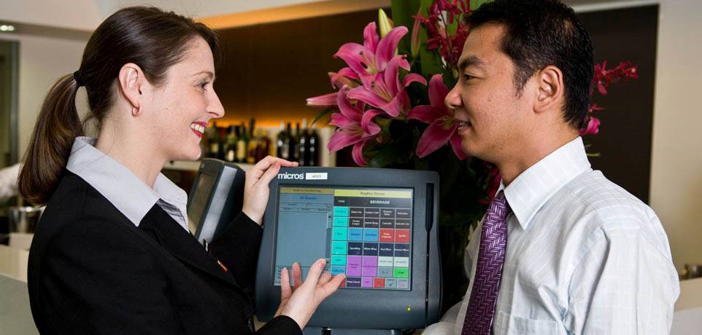
Assessment
Assessment for this unit may include:
Oral questions
Written questions
Work projects
Workplace observation of practical skills
Practical exercises
Formal report from supervisor
Notes:
Trainer advises that assessment for this Unit may take several forms all of which are aimed at verifying they have achieved competency for the Unit as required.
Trainer indicates the methods of assessment that will be applied to them for this Unit.

Slide 4
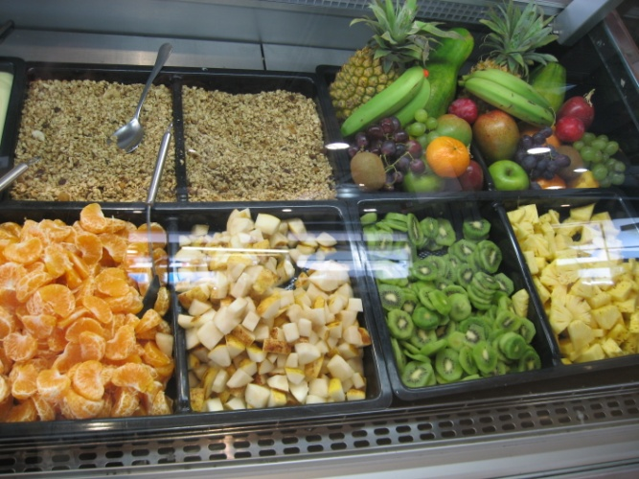
Prepare food and/or food and beverage outlet for service
1
Notes:
Introduce topic.
Class Activity – General Discussion
Ask general questions:
What types of food and beverage establishments exist?
What preparation needs to take place at the start of the day?

Slide 5
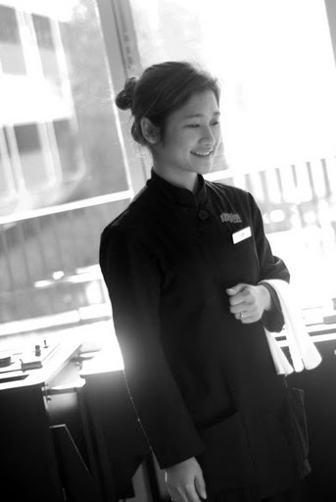
Prepare food and/or food and beverage outlet for service
Performance Criteria for this Element are:
Check food service area and customer facilities for cleanliness prior to service, in accordance with enterprise procedures, and where required, take corrective action/s
Check and prepare equipment for service
Check cleanliness and condition of tables and all table items, prior to service and take necessary corrective action
Notes:
Trainer identifies the Performance Criteria for this Element, as listed on the slide.

Slide 6
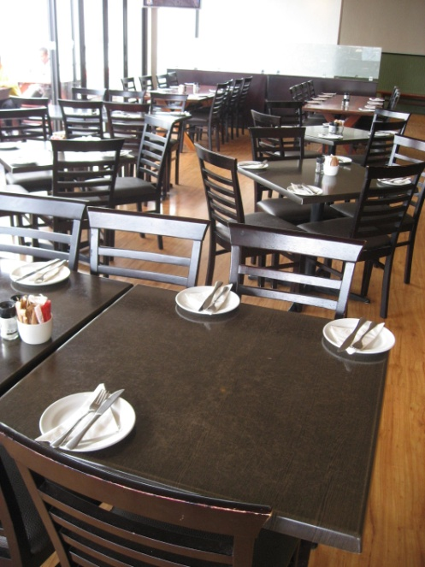
Preparing a food and beverage outlet
The preparation of a restaurant is vital for the efficient and successful running of any meal shift.
Things need to be:
Checked
Stocked
Positioned
Cleaned
Notes:
Class Activity – General Discussion and List
Get audience to answer following question/s:
Provide examples of what needs to take place under each preparation step

Slide 7
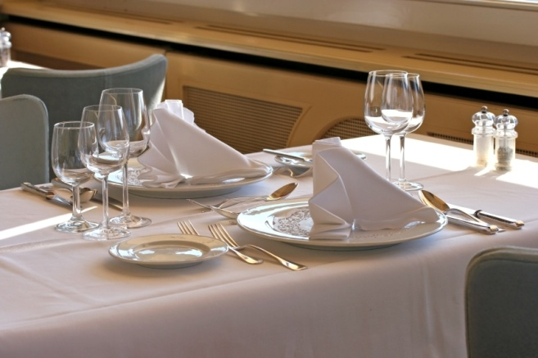
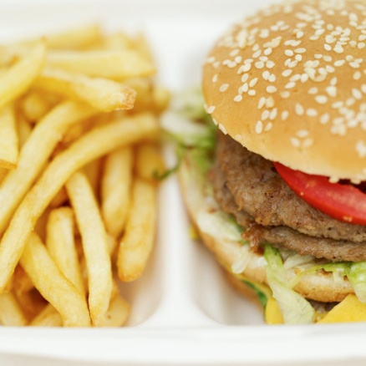
Types of food and beverage outlets
The industry boasts a wide variety of food and beverage outlets.
What types of food and beverage outlets exist?
What specific preparation activities need to be performed that are different from the norm?
Notes:
Class Activity – General Discussion and List
Get audience to answer following question/s:
Identify different types of eateries they visit ranging from fast food to formal dining and drinking.
Identify what preparation needs to take place that is different.

Slide 8
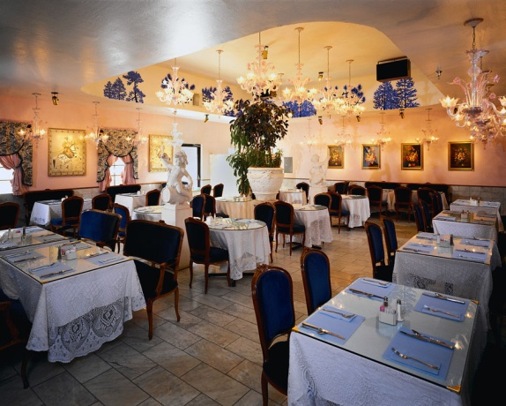
Checking and cleaning restaurant area
Areas to check for cleanliness may include:
Furniture – tables and chairs
Wall hangings – pictures or displays
Fixtures – light fittings and door knobs
Plants – indoor plants and pots
Notes:
Class Activity – General Discussion
Get audience to:
Provide examples of what needs to take place under each preparation step

Slide 9
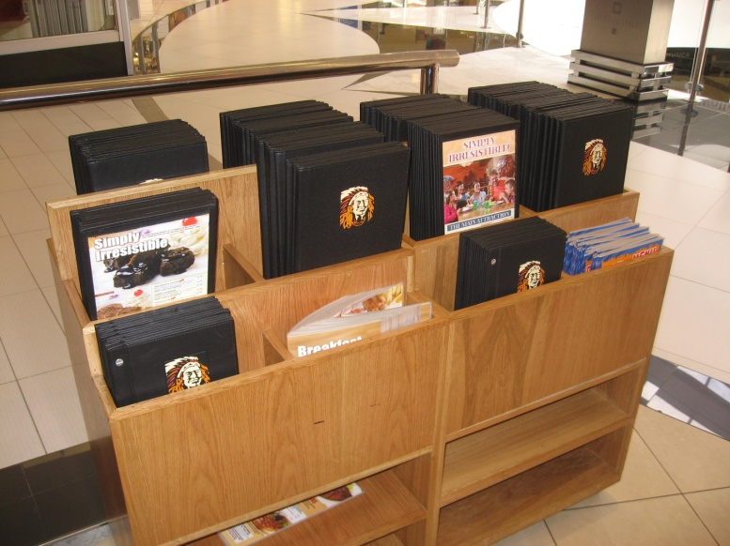
Checking and cleaning restaurant area
Areas to check for cleanliness may include:
Glass – windows, panels and doors
Floor – carpet and tiled areas
Work stations – waiter’s sideboard
Menu stands – at host area
Toilets – rest areas
Operating equipment – coffee machine, blender, toaster, carving trolley etc
Notes:
Class Activity – General Discussion
Get audience to:
Provide examples of what needs to take place under each preparation step

Slide 10

Checking and cleaning customer facilities
Waiting area/foyer:
Front entrance
Cloak room
Seats
Tables
Magazines
Menus
Notes:
Class Activity – General Discussion
Get audience to:
Provide examples of what needs to be prepared for each step identified in the slide.
Why is it important?

Slide 11
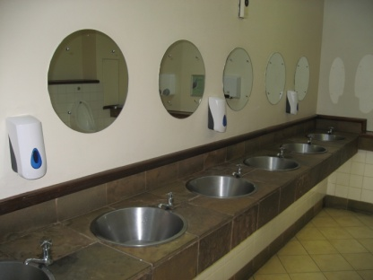
Checking and cleaning customer facilities
Restrooms:
Benches
Toilet cubicles and urinals
Soap and sanitiser
Hand towel dispenser
Waste paper basket
Floor
Clean and hygienic smell
Use a Checklist to help with inspections.
Notes:
Class Activity – General Discussion
Get audience to:
Provide examples of what needs to be prepared for each step identified in the slide.
Benches – making sure they are free from water, soap scum, tissues and glassware
Toilet cubicles – checking they are stocked with toilet paper, the toilet bowl and seat clean
Urinal – checking they are clean and in good working order, deodorant blocks supplied where appropriate
Hand towel dispenser – making sure it is stocked with woven paper towels
Hand dryer – verifying it is clean and in good working order
Waste paper basket – emptying it as required and ensuring it is not overflowing, and is fitted with a bin liner that is in good order
Floor – making sure it is clean and free from rubbish and liquid spillage
Making sure the area has clean and hygienic smell.

Slide 12
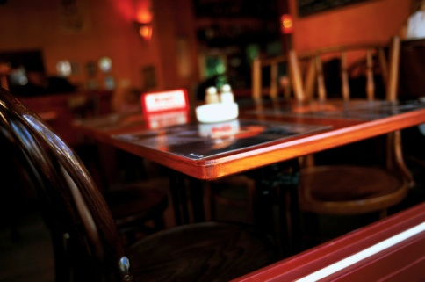
Checking and cleaning customer facilities
Smoking areas:
Checking that the cleaning of this area has been done
Doing spot cleaning of areas
Placing ashtrays
Placing advertising material
Watering plants
Use a Checklist to help with inspections
Notes:
Class Activity – General Discussion
Get audience to:
Provide examples of what needs to be prepared for each step identified in the slide.
Why is it important?

Slide 13
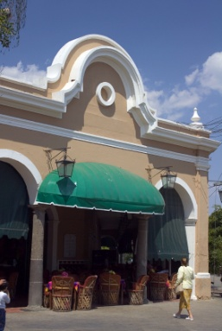
Checking and cleaning customer facilities
External areas
External areas are areas outside the premises and can include footpaths, gardens and car parks:
Sweeping or hosing an area
Picking up rubbish
Collecting any glasses that guests may have taken outside
Notes:
Class Activity – General Discussion
Get audience to:
Provide examples of what needs to be prepared specifically for external areas that have not been mentioned in this slide?.
Why is it important?

Slide 14
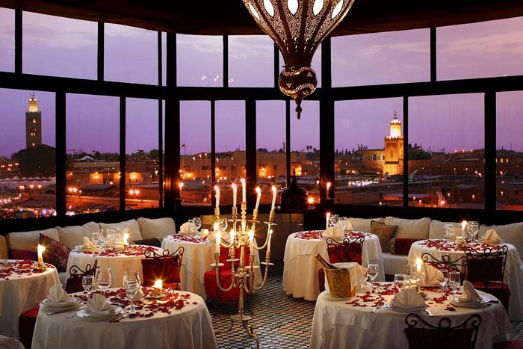
Prepare comfort and ambiance
The ambience and comfort level of a restaurant must be taken into consideration when preparing for service.
This normally takes into consideration:
Temperature
Noise
Lighting
Notes:
Class Activity – General Discussion
Get audience to answer following question/s:
How can you create ambiance and comfort?
Why is it important for patrons?

Slide 15
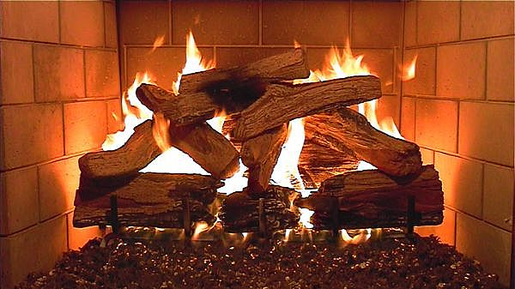
Prepare comfort and ambiance
Temperature:
Set at a ‘Comfortable’ temperature
Considering outside weather
Considering expected trade
Generally speaking, the temperature level should be a ‘set and forget’ issue
Notes:
Class Activity – General Discussion
Get audience to answer following question/s:
What is a comfortable temperature?
How do you control temperature?

Slide 16
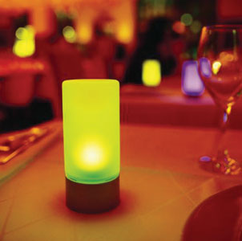
Prepare comfort and ambiance
Lighting
Checks must be made to ensure:
No blown bulbs
No flickering fluorescents
Dimmers are set at the correct setting
Lights are on or off as required
Notes:
Class Activity – General Discussion
Get audience to answer following question/s:
What is the correct lighting?
How can you establish mood lighting?
How can you make lighting safe for patrons to notice steps and other dangerous items such as table corners?

Slide 17

Prepare comfort and ambiance
Volume/Music
The music should aim to:
Appropriate for the meal period and theme
Provide a background to the dining experience
Mask conversations of other patrons
Create atmosphere
Notes:
Class Activity – General Discussion
Get audience to answer following question/s:
What is ‘appropriate music’ for each meal time?
How can you provide this music?

Slide 18
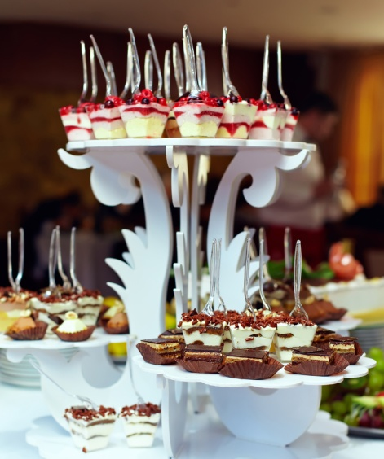
Prepare comfort and ambiance
Other considerations:
Table decorations
Floor displays
Smells
What other ways can you create comfort and ambiance?
Notes:
Class Activity – General Discussion
Get audience to:
Think of other ways to create comfort and ambiance.

Slide 19
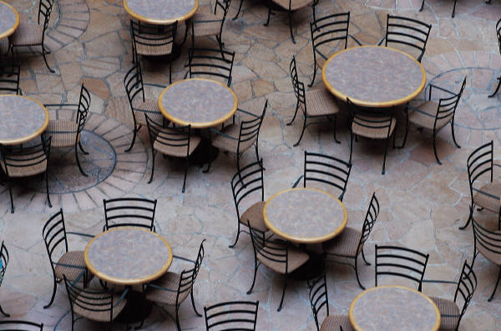
Set up furniture
Another major task in preparing a food and beverage service area for service is to set up the furniture in the room
‘Furniture’ primarily refers to tables and chairs
Notes:
Class Activity – General Discussion
Get audience to answer following question/s:
What furniture is needed in a restaurant?
What determines their style and layout?

Slide 20
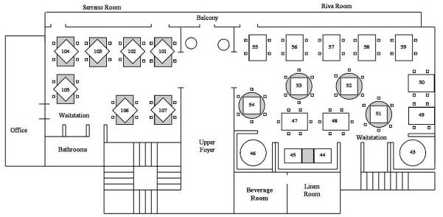
Set up furniture
Floor plan
A floor plan is a map of how the tables are to be positioned in a dining area/restaurant.
Notes:
Class Activity – General Discussion
Get audience to answer following question/s:
What does a manager need to consider when thinking about a floor plan?

Slide 21
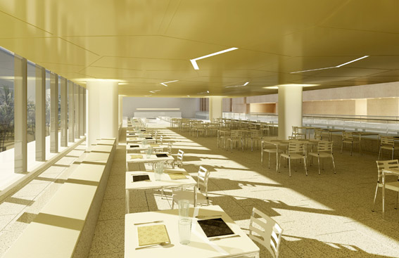
Set up furniture
Floor plan
A floor plan sets out:
Where the tables will be physically positioned
The number of covers on each table
The table numbers
Which waiters will serve which tables
Notes:
Class Activity – General Discussion
Get audience to answer following question/s:
What does a manager need to consider when thinking about a floor plan?

Slide 22
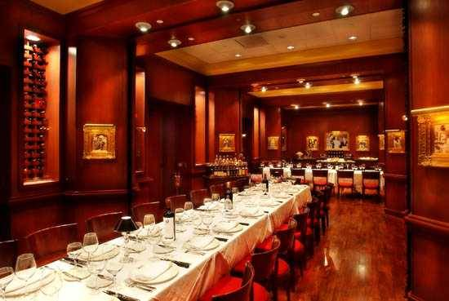
Set up furniture
Floor plan considerations
Reservations:
Number of guests
Size of bookings
Customer’s arrival time
Customer/party name
Special requests
Needs of guests
Contact details
Notes:
Class Activity – General Discussion
Get audience think about the impact these reservation details will have for a floor plan:
Number of guests – including type of guests. For example, a baby may require a high chair.
Also, the size of some bookings can indicate where there table has to be placed simply because it won’t fit in certain locations
Customer’s arrival time
Special requests – such as the guest requesting a specific table number, a table that has a view of the lake, isn’t near the entrance door or is close to the dance floor
Needs of guests – such as wheelchair access, stated need to be in a private location

Slide 23
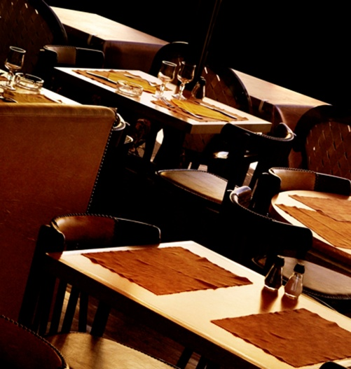
Set up furniture
Floor plan considerations
Shape and design of the room:
Tiered floors
Location and size of dance floors
Location of windows
Number and size of entertainment areas
Required thoroughfares
The amount of room required for staff movement
Location and number of booths or alcoves
Notes:
Class Activity – General Discussion
Get audience to think about the impact the room shape and design will have on a floor plan:
Shape and design of the room
This involves taking into account the structure of the room in relation to issues such as:
Tiered floors – split level dining areas are notoriously difficult to prepare a table plan for as they tend to waste a lot of space
Location and size of dance floors
Location of windows
Number and size of entertainment areas
Required thoroughfares – to allow both guest access to tables, toilets etc. and to al­low staff sufficient room to move around the floor and service ce the tables.
The amount of room required for staff movement must reflect the style of service be­ing offered – for example, more room is needed between tables if gueridon trolleys are going to be used as part of the service.
Most floor plans will allow several primary service routes for waiting staff to take on the floor so that all the tables can be serviced
Location and number of booths or alcoves that exist in the room – if applicable

Slide 24
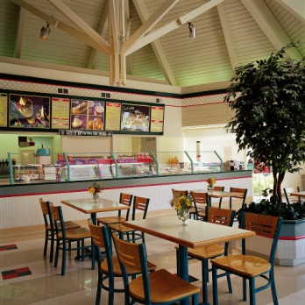
Set up furniture
Floor plan considerations
Immovable objects:
Within most rooms there will be various objects that cannot be moved and there is therefore a need to plan around them.
They include:
Waiters stations
Pillars
Staircases
Display cases
Notes:
Class Activity – General Discussion
Get audience to think about the impact immovable objects will have on a floor plan:
Immovable objects
Within most rooms there will be various objects that cannot be moved and there is therefore a need to plan around them. They include:
Waiters stations
Pillars
Staircases
Display cases

Slide 25
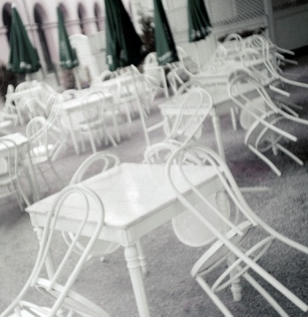
Set up furniture
Floor plan considerations
Style of furniture
These will also influence the layout of the floor plan. Factors involved are:
Shape of tables
Size of tables
Type of chair used at the tables
Notes:
Class Activity – General Discussion
Get audience to think about the impact styles of furniture will have on a floor plan:
Style of furniture
These will also influence the layout of the floor plan. Factors involved are:
Shape of tables – round, square, half-moon, quarter-circle
Size of tables – two-person, or four-person
Type of chair used at the tables

Slide 26

Set up furniture
Floor plan considerations
Exits and doors
The location of doors and whether or not they open inwards or outwards must be taken into account in relation to:
Service doors
Fire exits
Restroom doors
Main entrance to the room
Notes:
Class Activity – General Discussion
Get audience think about the impact exits and doors will have on a floor plan.

Slide 27
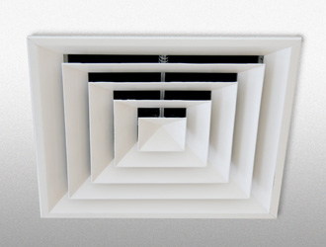
Set up furniture
Floor plan considerations
Future considerations
Further points that may need to be factored in include:
Leaving space for guests to move in and out from their table
Providing customers with enough space around the table to grant a level of privacy
Avoiding placing tables in ‘uncomfortable’ areas
Making provision for hats and coats
Notes:
Class Activity – General Discussion
Get audience think about the impact other considerations will have on a floor plan:
Further considerations
Further points that may need to be factored in include:
Leaving space for guests to move in and out from their table with safety and without having to ask others to stand up
Providing customers with enough space around the table to grant a level of privacy – placing tables ‘too close’ to others is to be avoided
Avoiding placing tables in draughty areas, directly under speakers or air conditioning, or too close to waiter’s stations
Making provision for hats and coats, where applicable

Slide 28

Set up furniture
Customer and service personnel access
Access routes into the room and between tables must ensure:
The ability of all patrons to move freely to and from their tables
Room for staff to service individual tables
Room for staff to wheel service trolleys
Ease of access to facilities in the room
Waiting staff can have freedom of movement around their waiting stations
Notes:
Class Activity – General Discussion
Get audience to think about the impact of customer and service personnel access:
Access routes into the room and between tables must ensure:
The ability of all patrons to move freely to and from their tables
Room for staff to service individual tables – that is, to move freely and easily around individual tables
Room for staff to wheel service trolleys around the room and to individual tables
Ease of access to facilities in the room – such as toilets, viewing areas and service points such as bars, food pick-up points and dance floor
Waiting staff can have freedom of movement around their waiting stations.

Slide 29
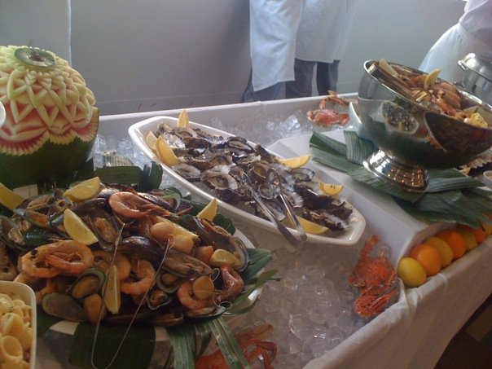
Display food and beverage items
What food and beverage items are commonly displayed?
Where are they displayed?
How do staff promote them?
How do you display hot food in a hygienic manner?
How do you display cold food in a hygienic manner?
Notes:
Class Activity – General Discussion
Get audience to think about food and beverage items displayed in an outlet.

Slide 30
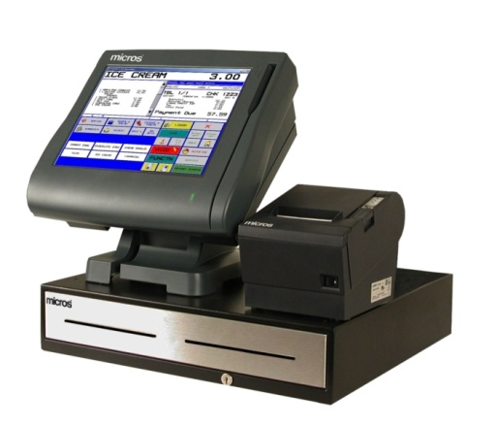
Prepare equipment
Once the restaurant area is ready for service, it is now time to prepare the equipment.
What equipment items need to be prepared?
What auxiliary items that accompany equipment need to be set up?
Notes:
Class Activity – General Discussion
Get audience to think about and identify all equipment and auxiliary items that need to be prepared.

Slide 31
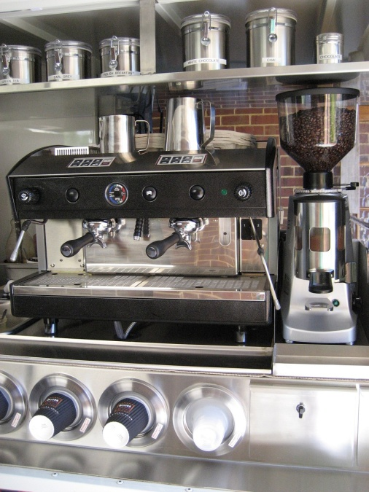
Prepare equipment
Coffee Area:
Coffee machine
Cups
Saucers
Teaspoons
Sugar
Milk jugs
Types of milk
Types of coffee
Accompaniments (biscuits)
Napkins
Notes:
Class Activity – General Discussion
Discuss the steps associated with setting up coffee area.

Slide 32
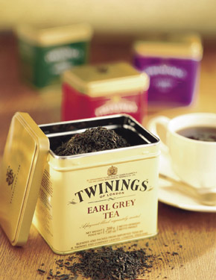
Prepare equipment
Tea Area:
Cups
Saucers
Teaspoons
Sugar
Milk jugs
Types of tea
Lemon
Notes:
Class Activity – General Discussion
Discuss the steps associated with setting up coffee area.

Slide 33
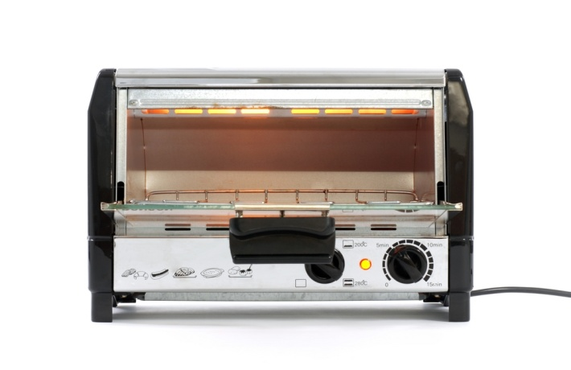
Prepare equipment
Service Equipment
Bain maries
Toasters
What other service equipment is used?
Notes:
Class Activity – General Discussion
Discuss the steps associated with organising other equipment.

Slide 34
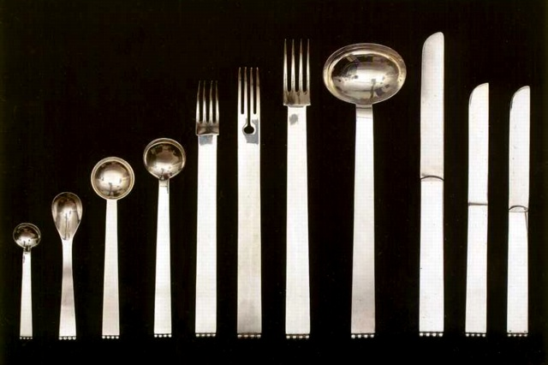
Prepare equipment
Cutlery:
Knives (main and entrée)
Forks (main and entrée)
Soup spoons
Dessert spoons
Hot chocolate spoons
Teaspoons
Seafood cutlery
Notes:
Class Activity – General Discussion
Discuss the different types of cutlery used in a food and beverage outlet.
How can you ensure cutlery is clean?

Slide 35
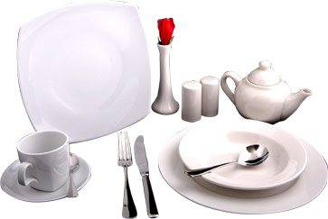
Prepare equipment
Crockery:
Plates (main and entrée)
bowls (soup, salad and dessert)
Butter dishes
Salt and pepper shakers
Sugar bowls
Notes:
Class Activity – General Discussion
Discuss the different types of crockery used in a food and beverage outlet.
How can you ensure crockery is clean?

Slide 36
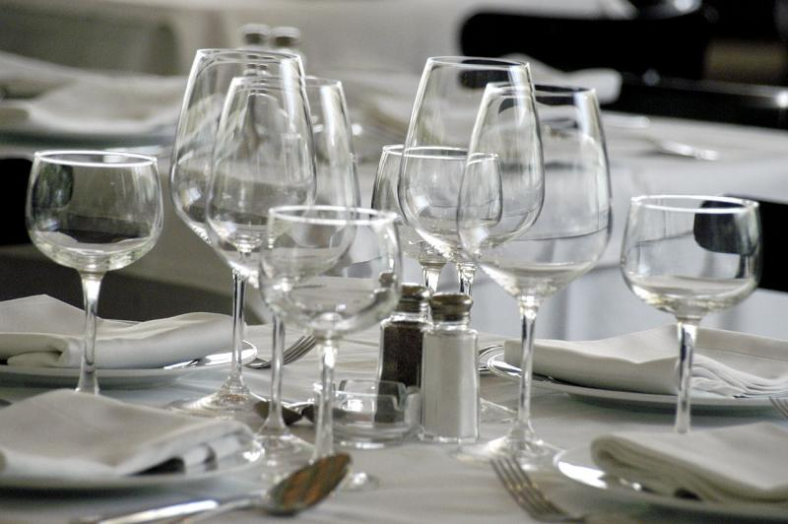
Prepare equipment
Glassware:
Beer glasses
Wine glasses
All-purpose glasses
Cocktail glasses
Liqueur glasses and fortified wine glasses
Carafes wines to table
Jugs drinks
Irish coffee/liqueur-spirit coffee mugs
Notes:
Class Activity – General Discussion
Discuss the different types of glasses used in a food and beverage outlet.
How can you ensure glassware is clean?

Slide 37
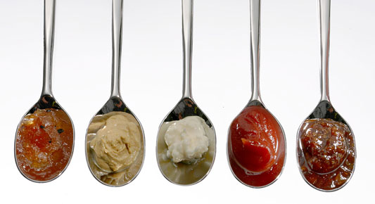
Prepare equipment
Condiments
Sauces
Lemon
Mustards
Chilli
Butter
Salt and pepper
Salsa
Fruit, vegetables and herbs
Notes:
Class Activity – General Discussion
Discuss the different types of condiments used in a food and beverage outlet.
What preparation activities need to take place to ensure these are ready?

Slide 38
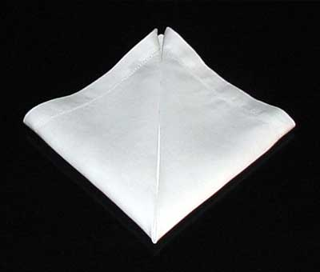
Prepare equipment
Napkins
Preparing napkins includes ensuring they are:
Clean
Have no holes
Are prepared/folded
Notes:
Class Activity – General Discussion
Discuss the different types of napkin materials are used in a food and beverage outlet.
What forms are napkins commonly found (packaged and disposable etc.)?

Slide 39
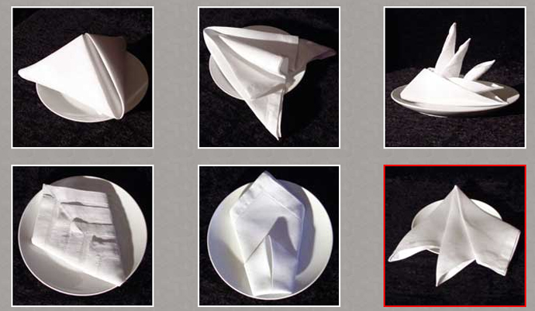
Prepare equipment
Napkins
Types of napkin folds:
Cone
Bishops Hat
Fan
Opera House
Sail
Notes:
Class Activity – General Discussion & Demonstration
What are common folds?
Trainer may demonstrate a number of common napkin folds.

Slide 40
Prepare equipment
Waiter’s Station:
Menus and wine lists
Cutlery and crockery
Service cutlery
Napkins
Service trays
Docket books
Toothpicks
Notes:
Class Activity – General Discussion
Discuss the different items commonly found at a waiter’s station.
What preparation activities need to take place to ensure these are ready?

Slide 41
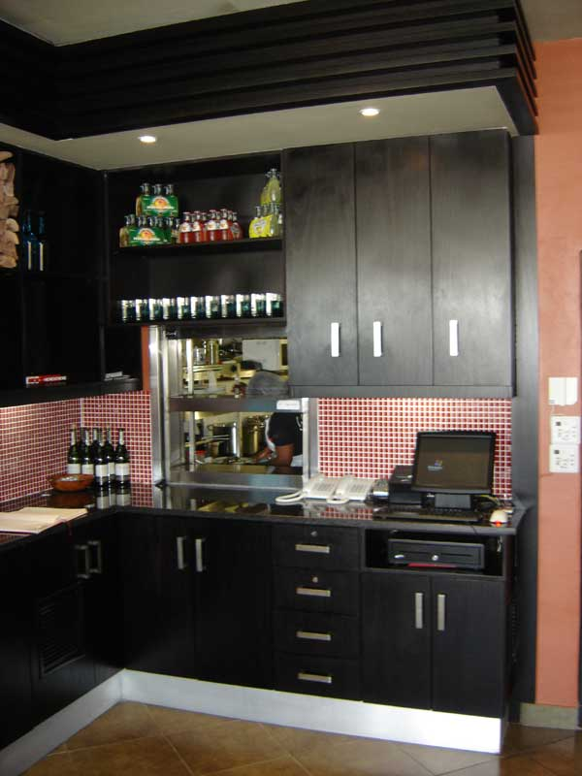
Prepare equipment
Waiter’s Station:
Condiments
Glassware
Pens
Matches
Ashtrays
Waiters apron
Nuts
Notes:
Class Activity – General Discussion
Discuss the different items commonly found at a waiter’s station.
What preparation activities need to take place to ensure these are ready?

Slide 42
Removing, cleaning or replacing items
High chairs
Trestle tables
Bain-maries
Coffee urns
Equipment used only for the breakfast shift
Glassware
Notes:
Class Activity – General Discussion
If you remove these items, where do you place them?
When would they be needed again?

Slide 43
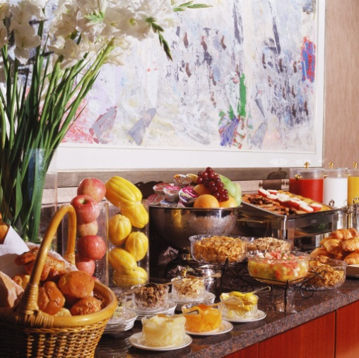
Removing, cleaning or replacing items
Broken equipment or furniture
Used customer comment forms
Stock (food and beverage items)
Displays
Mobile trolleys
Notes:
Class Activity – General Discussion
If you remove these items, where do you place them?
When would they be needed again?

Slide 44
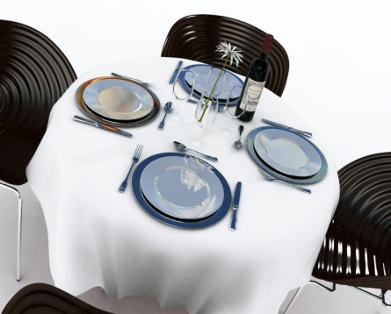
Setting tables
Once the room setting and equipment is set up it is now time to set the tables to meet the expected trade for the meal period:
What types of setting can you prepare?
What cutlery and crockery is needed?
Notes:
Class Activity – General Discussion
Discuss the different types of settings?
What cutlery is needed for these settings?
What crockery is needed for these settings?

Slide 45
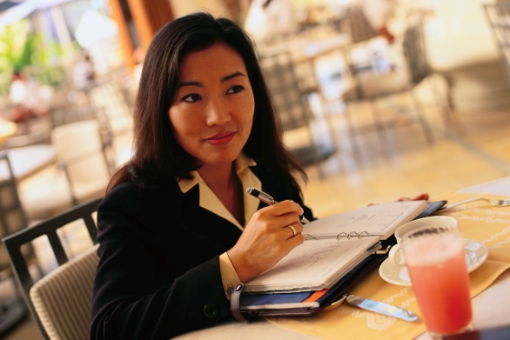
Setting tables
A cover
A place setting for one guest is commonly known in the industry as a ‘cover’.
Notes:
Class Activity – General Discussion
What is a cover?

Slide 46

Setting tables
À la carte cover:
À la carte is the term used for a menu that has individually priced dishes
These dishes are divided into entrées, salads, mains and desserts
À la carte means ‘from the card/menu’
This type of cover is popular
Notes:
Class Activity – General Discussion
What items are included in à la carte cover?
What types of food and beverage establishments use this type of cover?

Slide 47
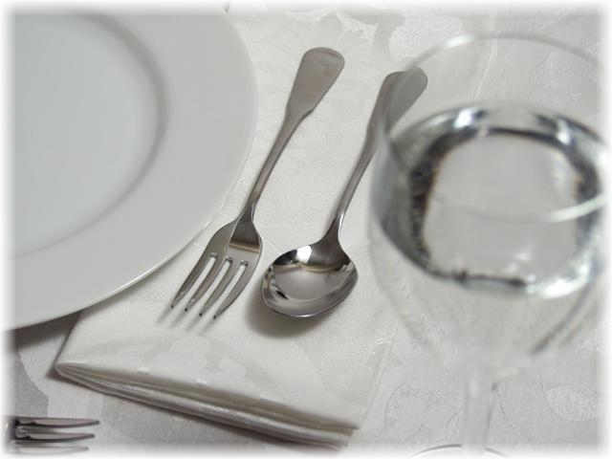
Setting tables
À la carte cover
This cover usually consists of:
Main course knife
Main course fork
Side plate
Side knife
Wine glass
Napkin
Centre pieces
Notes:
Class Activity – General Discussion & Demonstration
What are common centre pieces?
These include salt and pepper shakers, table numbers, vases or tent cards
The trainer may demonstrate setting this type of cover, explaining reasoning.

Slide 48
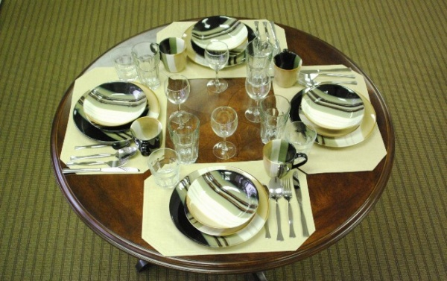
Setting tables
Table d’hôte cover
A table d’hôte menu is a menu that has a set price for a number of courses
‘Table d’hôte’ means ‘table of the host’
All courses are included in the price and must be paid for by the guests even if they don’t eat every course
This is often called a ‘set menu’
Notes:
Class Activity – General Discussion
What items are included in a table d’hôte cover?
What types of food and beverage establishments use this type of cover?

Slide 49
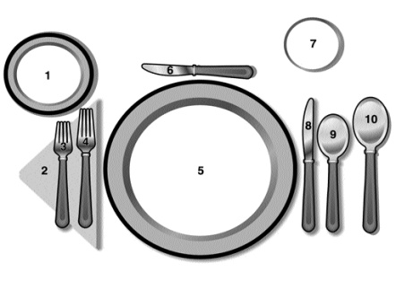
Setting tables
Table d’hôte cover
The cover for this menu would be:
Main course knife and fork
Entrée knife and fork
Dessert spoon and fork
Side plate and knife
Wine glass
Napkin
Centre pieces
Notes:
Class Activity – General Discussion & Demonstration
What variations exist to this setting?
The trainer may demonstrate setting this type of cover, explaining reasoning.

Slide 50
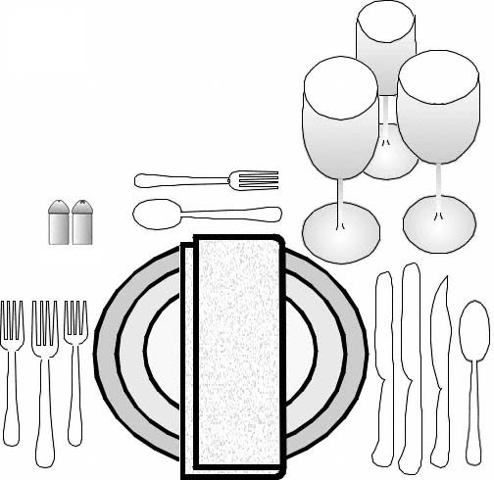
Setting tables
Complete Table Cover
Notes:
Class Activity – General Discussion & Demonstration
What items are included in this cover setting and why?
The trainer may demonstrate setting this type of cover, explaining reasoning.

Slide 51
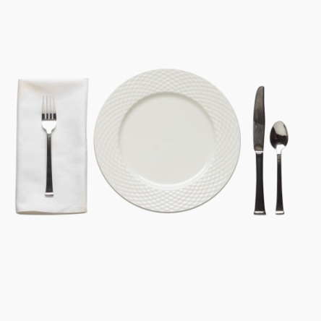
Setting tables
Tips for setting a table:
Use the chair as a guide to centre the cover
Side plates should always be placed to the left of the fork
Knife blades should always face left
Sufficient space should be left between the knife and fork for the meal to be placed down
Notes:
Class Activity – General Discussion
Discuss the reasoning behind these tips.

Slide 52
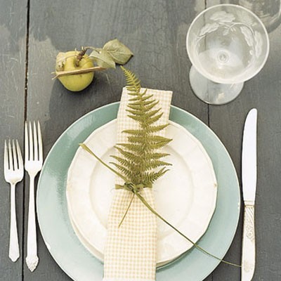
Setting tables
Tips for setting a table:
Entrée cutlery should always be placed on the outside of the main course cutlery
In à la carte dining, the dessert cutlery should be placed where the main course knife is usually positioned
Wine glass should be placed directly above the main knife
Notes:
Class Activity – General Discussion
Discuss the reasoning behind these tips.

Slide 53
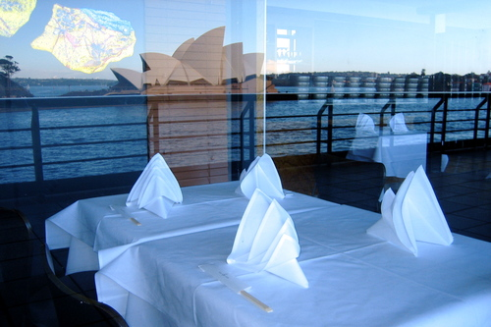
Setting tables
Clothing a table:
Clean linen
Never let cloth touch ground
Laid right side up
Same level of overhang on each side
Crease middle if using more than 1 cloth
Creases should not be seen at the door
Use clean napkins
Notes:
Class Activity – General Discussion and Demonstration
What items are included in clothing a table?
The trainer may demonstrate clothing a table

Slide 54
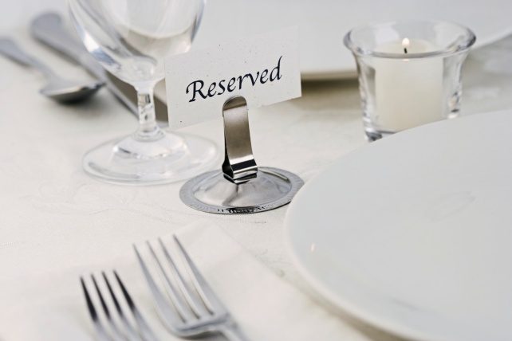
Setting tables
Checking tables prior to service
Cleanliness and the condition of the tables and the table items must be checked prior to service to ensure the guests enter a proper and correctly prepared room.
What would you check and why?
Notes:
Class Activity – General Discussion
What would you check and why?

Slide 55
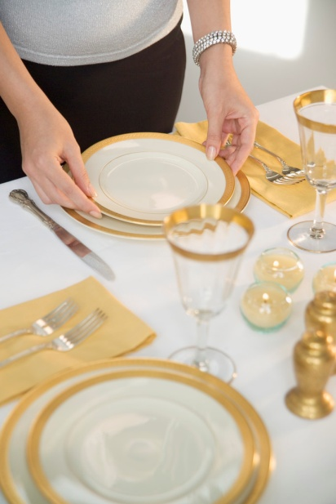
Setting tables
Checking tables prior to service
Crumbs on chairs
Lop-sided, creased, dirty or otherwise unsuitable table cloth
Missing items from the cover or table
Missing, damaged or unstable tables and chairs
Incorrect covers set on a table
Actual table positions reflect the set floor plan
Rubbish
Flies or insects
Notes:
Class Activity – General Discussion & Demonstration
Crumbs on chairs – left from the previous session: cleaners will clean the floor of the room but rarely be required to clean chairs
Lop-sided, creased, dirty or otherwise unsuitable table cloth
Missing items from the cover or table – crockery, cutlery, centre pieces, glassware, napkins, tent cards
Missing, damaged or unstable tables and chairs
Incorrect covers set on a table – the covers must reflect the number of guests for each table as indicated on the floor plan. Where tables exist that do not have bookings, most venues will prepare tables to suit the size of walk-in numbers/parties that can be reasonably expected. This means they may set up a number of tables for two, some tables for four people and some for (perhaps) six or eight people
That the actual table positions reflect the set floor plan
Rubbish on the floor, in pot plants etc.
Flies or insects – alive or dead, with special attention being paid to window ledges.

Slide 56
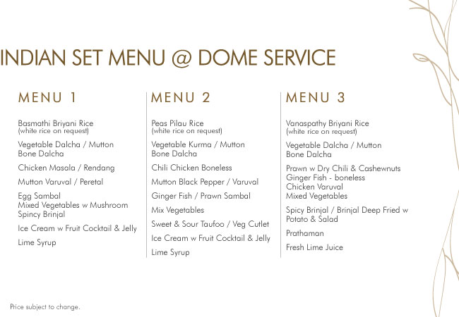
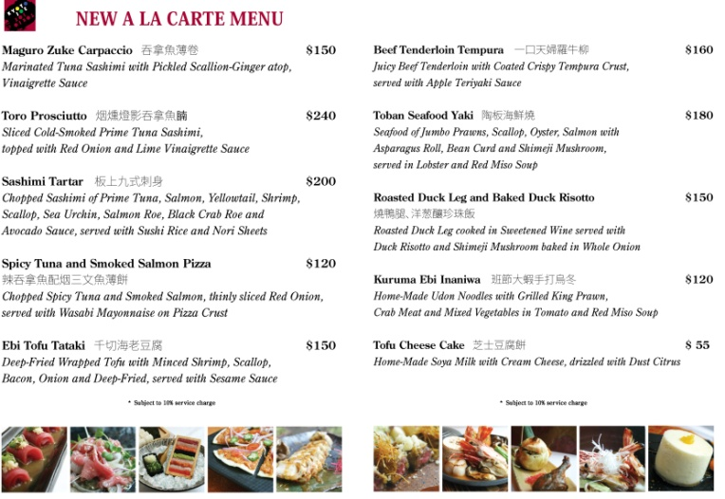
Setting tables
Verify Menu
Types of menus:
à la carte menu
Set menu
Beverage menu
What is in the beverage menu?
Notes:
Class Activity – General Discussion
What information should you verify?
Who provides this information?

Slide 57
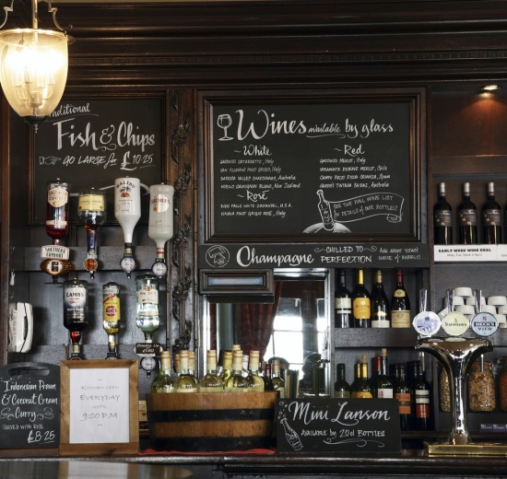
Setting tables
Verify Menu Items
Some specials or variations that could occur on a daily or service by service basis may include:
Fish of the day
Soup of the day
Specials of the day
Vegetables of the day
Dessert of the day
Specific constraints on this individual upcoming session
Notes:
Class Activity – General Discussion
Who provides this information?

Slide 58

2
Take and Process Orders
Notes:
Introduce topic.
Class Activity – General Discussion
Ask general questions:
What are the steps associated with taking orders?
What equipment can be used to help with this process?

Slide 59
Take and process orders
Performance Criteria for this Element are:
Provide a helpful and attentive approach to customers
Take and record orders accurately and legibly
Convey orders promptly to the kitchen and/or bar
Give customers advice on product selections, if required
Notes:
Trainer identifies the Performance Criteria for this Element, as listed on the slide.

Slide 60

Welcoming guests
You never get a second chance to make a good first impression:
What is a good way to welcome customers to a food and beverage establishment?
Notes:
Class Activity – General Discussion
What is a good welcome?

Slide 61

Check reservations
Name of booking
Reservation/No reservation
Confirm number of guests
Smoking and non smoking
Special requests
Notes:
Class Activity – General Discussion
Where are reservations normally kept?
What happens if a customer says they have a reservation but it cannot be found in your records?

Slide 62

Greeting
Give an appropriate greeting:
What is a good way to greet a customer?
What are ‘ice-breaking’ conversations that you can initiate?
Notes:
Class Activity – General Discussion
Suggested topics include:
The weather – a genuine comment: “Isn’t it cold today?” – can be a great ice-breaker and help strike up a conversation
Sporting events – “Did you watch the game today?”
Special events – “Happy Festival Day”
The season – “Isn’t it getting dark early these days?”
A special in-house event – “Welcome to our Grand Winery Tour Dinner, it will be a night to remember!”

Slide 63

Special needs customers
Making suitable accommodation:
Alternative easy access to their table because of a disability
Privacy for romantic couples and business people
Room on a table to spread out business documents
A table near the door for someone with a walking stick
A high chair for infants
Warming of a bottle for babies
Special dietary needs
Notes:
Class Activity – General Discussion
In a given restaurant setting, how would you accommodate these special needs?

Slide 64

Pre-meal services
Offer pre-meal services:
Seat
Magazine/newspaper
Menu
Beverage
Snack
Notes:
Class Activity – General Discussion
How would you offer these pre-meal services?

Slide 65

Escort and seat customers
“Follow me”
Walk at a comfortable pace
Acknowledge any dangers
Pull our chairs
Push in chairs
Ensure adequate seating
Remove excess chairs
Lap napkins
Communication
Notes:
Class Activity – General Discussion and Demonstrate
Demonstrate how to undertake escorting activities.

Slide 66

Present menus
Distribute menus to the guests from their right-hand side
Leave the wine list with the host
Offer starter items
Notes:
Class Activity – General Discussion
Discuss points.

Slide 67

Provide helpful information
Providing food-related information to guests:
Explain any queries
Use attractive words
Use simple terminology
Explain specials of the day
Explain items that are unavailable
Make recommendations if required
Give customers time to think
Notes:
Class Activity – General Discussion and Role Play
Participants to practice giving information based on a menu chosen by the trainer

Slide 68

Provide helpful information
Making recommendations:
Items you think they might like – ask questions
Items you like and why
Items that are popular
Specials of the day
Items the kitchen wants you to sell
Food and Wine Combinations
Notes:
Class Activity – General Discussion and Role Play
Participants to practice giving recommendations based on a menu chosen by the trainer

Slide 69

Taking orders
Options available:
Staff may be required to:
Remember orders
Record orders on paper-based order forms
Record orders using electronic means
Notes:
Class Activity – General Discussion
Discuss the advantages/disadvantages of using these methods and when they would best be used:
Remember orders - relying solely on their memory, as is the case at most bars and in some restaurants
Record orders on paper-based order forms – such as waiter’s dockets and order pads
Record orders using electronic means – such as small hand-held computers (PDAs – Personal Digital Assistants) which also send the orders to the kitchen or bar and interface with point-of-sale registers to facilitate account tracking, processing and payment.

Slide 70

Taking orders
The role of the order:
The order serves four different purposes:
Informs the kitchen or bar staff of the order
Informs the service staff of any changes needed to the cutlery
Identifies who is eating or drinking the items ordered
Provides information for accounts
Notes:
Class Activity – General Discussion
Discuss the role of the order including:
Informs the kitchen or bar staff of the order – so that they can produce the items required by the customers
Informs the service staff of any changes needed to the cutlery. Some may need to removed, some may need to be added or exchanged
Identifies who is eating or drinking the items ordered – so that the right item can be served to the correct guest
Provides the basis from which an account can be made up and presented to the customer at the end of the dining experience.

Slide 71

Taking orders
Guidelines for taking the order:
Look for signs when guests are ready to order
Start with females
Record clockwise or number guests
Record all orders accurately and legibly
Notes:
Class Activity – General Discussion & Demonstration
Demonstrate the steps associated with taking an order.

Slide 72

Taking orders
Guidelines for taking the order:
Record special requirements:
Sauces
Temperatures
Extras / exclusions
Separate courses
Repeat order
Notes:
Class Activity – General Discussion and Demonstration
Demonstrate the steps associated with taking an order.

Slide 73

Taking orders
Degrees of ‘doneness’ of steaks
It is important to note on the order how the guest wants their steak cooked.
Degrees of doneness are:
Blue
Rare
Medium rare
Medium to well-done
Well-done
Notes:
Class Activity – General Discussion
Discuss the different degrees of doneness:
Blue - steak is seared on both sides then served
Rare - steak is served when browned on both sides, and meat still contains blood
Medium rare - steak has less blood than a rare steak, though blood is still just present
Medium to well-done - steak is cooked all the way through, no sign of blood
Well-done: steak is cooked very well – a little burnt on the outside and definitely no sign of blood.

Slide 74

Operate the ordering system
All transactions should be undertaken within establishment guidelines relating to:
Honesty and integrity
Accuracy
Speed
Explanation and description of charges
Customer service
Notes:
Class Activity – General Discussion
Discuss the importance of operating ordering systems.
All transactions should be undertaken within establishment guidelines relating to:
Honesty and integrity – these address not charging for items that were not delivered or not charging person X for something that person Y received
Accuracy – checking all entries, extensions, additions and other calculations to make sure that the customer isn’t overcharged and that the venue captures all the revenue to which it is legitimately entitled
Speed – ensuring that accounts are compiled and presented in a timely manner consistent with honesty and accuracy. Never sacrifice accuracy for speed
Explanation and description of charges – fully detailing the nature of all charges so that no confusion or suspicion about charges exists
Customer service – treating customers with the courtesy they merit in relation to the taking of the order, processing of the order and presentation of the account for payment.

Slide 75
Operate the ordering system
Using different systems
Orders can be taken using:
Manual system
Electronic system:
Point of sale terminals
Hand held devices
Print out terminals
Notes:
Class Activity – General Discussion, Demonstration and Role Play
The trainer should describe the benefits and methods of using each method of taking orders.
The participants should practice taking orders using each type of ordering system.

Slide 76

Convey orders
Regardless whether an electronic or manual ordering system is used to take an order, there are many times when waiter staff will need to speak directly to the person preparing items, normally the chef or bartender, to:
Explain special requests
Clarify the order
Notes:
Class Activity – General Discussion
What are examples of where information needs to be personally discussed with a chef or bartender?

Slide 77

Convey orders
Relaying information manually
In the event that a manual system is used, it is imperative that orders are:
Given directly to the person responsible for its preparation
Ensure they receive the order
Ensure they understand the order
Explain any special requests relating to an order
Notes:
Class Activity – General Discussion
What are common special requests?

Slide 78

Convey orders
Information to be relayed:
Timing issues
Cultural issues
Special requests
How steaks are to be cooked
Entrees required as main courses
Explanation of tables and their orders
Dietary requirements
Notes:
Class Activity – General Discussion
Discuss information that may need to be relayed.
Information that may need to be relayed involves:
Timing issues – informing the kitchen/bar of those who are in a hurry, or those who want to stretch their meal out over several hours
Coordination of service – telling the bar about the food that a table has ordered so that wines selected to accompany certain dishes can be presented, opened and served before the food has been served. It is very annoying and disappointing for a guest to choose a special wine to accompany their fish main course only to find that wine is served when they are halfway through that dish
Cultural issues – notifying the kitchen/bar of cultural food and drink needs. Sometimes patrons expect you to know what these needs, but in other instances individuals will advise you of what they want.
Dietary requirements
Special requests – in relation to serve size, extra this, no that or a special way of cooking that is not listed on the menu
How steaks are to be cooked
Entrees required as main courses – or vice versa
Explanation of tables and their orders – for example a table of six people where four are having entrees, and three are having soup and two are not having soup or entrees, what is required and when.

Slide 79

Convey orders
Types of special dietary needs:
Vegetarian requests
Lacto-ova vegetarians/Ova-lacto vegetarians
Lacto-vegetarians
Pescatarians
Vegan
Notes:
Class Activity – General Discussion
Discuss types of special dietary needs:
Vegetarian requests – this is probably the most common dietary-related request
Lacto-ova vegetarians/Ova-lacto vegetarians – these are the majority of ‘vegetarians’. They eat dairy products and eggs but not meat of any kind including red and white meat, poultry or fish
Lacto-vegetarians – they don’t eat meat, poultry or fish. They don’t eat eggs but they eat dairy products
Pescatarians – people who don’t eat meat, poultry or animal flesh but do eat fish
Vegan – this definition is open to various definitions so it is best to check exactly what. The diner means when they say they are a ‘vegan’. Generally a vegan can be seen as anyone who doesn’t eat meat, poultry, fish, eggs or dairy products and doesn’t eat foods derived from animals such as gelatine. The person may also stipulate that they are served only raw/unprocessed foods, or foods that have not reached a tempera­ture of above 46ºC (because they believe foods above this temperature have had some of their dietary goodness removed or be harmful to the human body)

Slide 80

Convey orders
Types of special dietary needs:
Requests for low-salt meals
Requests for low-sugar or no sugar meals
Requests for lactose-reduced milk
Requests for gluten-free food
Requests for a macrobiotic diet
Notes:
Class Activity – General Discussion
Discuss types of special dietary needs:
Requests for low-salt meals
Requests for low-sugar or no sugar meals – for diabetics
Requests for lactose-reduced milk – for those who are lactose intolerant
Requests for gluten-free food – from patrons who have celiac disease
Requests for a macrobiotic diet – for those who are especially health-focussed they will request unprocessed vegan foods, no oil and no sugar

Slide 81

Give customers advice
Answer customer questions:
Dish ingredients
Cooking/preparation time
MSG and flavourings
Serving sizes
Freshness of ingredients (seafood)
Notes:
Class Activity – General Discussion
Discuss points.

Slide 82

Give customers advice
Answer customer questions:
Cooking styles
Meat or meat stocks
Menu and cookery terminology
Side dishes
Calorie/fat content
Notes:
Class Activity – General Discussion
Discuss points.

Slide 83

Optimise sales
Sale of additional items:
Side salads, vegetables or French fries
Starch foods like wedges, fries, rice or other potato formats
Beverages to compliment meals
Additional sauces or condiments
Desserts
Notes:
Class Activity – General Discussion
What businesses are very good at doing this?
What are specific items that you can sell as additional items?

Slide 84

Optimise sales
Other methods to optimise sales:
Upsizing/upgrading meals
Package meal deals
Suggestive selling
Notes:
Class Activity – General Discussion
What businesses are very good at doing this?

Slide 85

3
Prepare and pack take away food and beverages
Notes:
Introduce topic.
Class Activity – General Discussion
Ask general questions:
What food and beverage businesses provide take away service?
Why is this type of service popular?
How can businesses provide this service?

Slide 86

Prepare and pack take away food and beverages
Performance Criteria for this Element are:
Present and pack food and beverage items in accordance with enterprise procedures and relevant health regulations
Apply safe food handling practices in accordance with enterprise procedures and relevant health regulations
Notes:
Trainer identifies the Performance Criteria for this Element, as listed on the slide.

Slide 87

Prepare and pack take away food and beverages
Performance Criteria for this Element are:
Dispose of spoiled products in accordance with enterprise procedures and relevant health regulations
Comply with correct food handling and food safety procedures
Notes:
Trainer identifies the Performance Criteria for this Element, as listed on the slide.

Slide 88

Take away food
‘Take-away’ service in simple terms is food and beverage that has been prepared for customers that will be transported to an outside location for consumption.
Notes:
Class Activity – General Discussion
What food and beverage is normally produced for take away?

Slide 89

Challenges of take away service
Take away service is different to eat-in customers which poses challenges that must be successfully negotiated by outlet staff:
What makes serving take away items harder?
What needs to be considered?
Notes:
Class Activity – General Discussion
Discuss questions in the slide.

Slide 90

Challenges of take away service
Challenges:
Food and beverage is prepared in its desired state
Food and beverage can be transported to another location easily
Food and beverage can maintain its quality during transportation, within a suitable time frame
Customers have all the necessary items required to enjoy the meal
Notes:
Class Activity – General Discussion
Discuss methods to ensure the challenges identified in this slide can be met.

Slide 91

Monitoring temperature
Keeping items hot during display
Hot food must be kept above 60 degrees celsius through use of:
Hot boxes
Bain-maries
Pots and pans
Heat lamps
Hot plates
Steamers
Heated display ovens
Notes:
Class Activity – General Discussion
How can you ensure items stay above this temperature?
How long should items be kept on display?
What items are kept hot under each type of equipment mentioned in this slide?
Activity: Demonstration and explanation
Trainer explains the different types of equipment stated in this slide.
If possible show the equipment to the audience. This may involve a tour of a kitchen.

Slide 92

Monitoring temperature
Recording temperatures
It is important to ensure that not only the outside of the food or beverage item is hot, but that the temperature has been retained through out the item:
Reading gauges
Thermometers
Notes:
Demonstration and explanation
Trainer explains the different types of temperature reading equipment stated in this slide.
If possible show the equipment to the audience. This may involve a tour of a kitchen.

Slide 93

Monitoring temperature
Keeping items hot in transit
In ‘take away’ service there is a time lag between when the food or beverage is prepared and when it is presented, and ultimately consumed by the customer.
How can food remain hot in transit?
Notes:
Trainer explains how food is maintained in hot food displays especially during transport.

Slide 94

Monitoring temperature
Keeping items hot in transit
The food or beverage container must be used to maintain heat:
Boxes
Concealed cups
Containers
Foil or plastic wraps
Bags
Notes:
Demonstration and explanation
Trainer explains the different types of containers stated in this slide.
If possible show the containers to the audience. This may involve a tour of a kitchen.
Activity: Discussion
For each of the above containers, identify what food or beverage is served in them.

Slide 95

Monitoring temperature
Keeping items cold during display
Food must be kept below 5 degrees celsius through use of:
Fridges
Freezers
Ice and dry ice
Notes:
Trainer explains how food is maintained in cold food displays.
Activity: Demonstration and explanation
Trainer explains the different types of equipment stated in this slide.
If possible show the equipment to the audience. This may involve a tour of a kitchen.

Slide 96

Protect displayed food from airborne and other contamination
Keep items:
In their correct temperatures
In packages or covered
Displayed for minimal time periods
In closed vessels
In closed display areas
Notes:
Trainer explains how food is protected from airborne and other contamination.
Discuss points.
If possible show the containers to the audience. This may involve a tour of a kitchen.
Activity: Discussion
What are different types of vessels or closed displays are used to help reduce airborne contamination?
What foods are stored in each?

Slide 97

Display items attractively
The primary concept of ‘take away’ service, and that of any food and beverage outlet, is to attract customers and to make a sale:
Visually entice the customer
Provide all the desired information to make an informed decision
Placement of items
Notes:
Trainer explains the importance of displaying items attractively.
Activity: Discussion
How have you been ‘enticed’ to purchase food before? What attracted you?
How can you visually entice the customer?
How can you provide all the desired information
What do you need to consider when placing items on display?

Slide 98

Display items attractively
Visually entice the customer:
Display the final product
Posters and pictures
Signs and menus
Descriptions
Smells and aroma
Notes:
Trainer explains the importance of visually enticing the customer.
Discuss points providing examples of each.
Activity: Discussion
Think of successful businesses who use each of these methods to entice customers.
Do you use posters? What do they show?
How can you use pictures?
What signs and menus do you use?
Would you change them to make them more attractive?
What would you change?

Slide 99

Display items attractively
Provide accurate information:
Cost, promotions or sales information
Weight or size
Ingredients
Preparation method
Health information including calorie or cookery methods
Allergy warnings
Spice content
Notes:
Trainer explains the importance of providing accurate information.
Discuss points providing examples of each.
Activity: Discussion
What information do customers want when they are deciding what food to offer?
Activity: Observation
Have a look at the menus promotions used in your outlet and see if the points in this slide are easily visible for customers.

Slide 100

Keeping food and beverage hygienic
Use appropriate food wrapping and packaging materials
Food wrappings and packaging materials are used to safely maintain and transport take away food, beverage and their accompanying items:
What items can be used?
Notes:
Trainer explains the importance of storing food wrapping and packaging materials correctly.
Discuss points.

Slide 101

Display items attractively
Types of wrapping and packaging:
Plastic, paper, waxed paper or foil wrappings
Plastic, cardboard or foam food containers
Foam, plastic or wax paper beverage vessels
Beverage vessel lids
Cardboard carrying containers
Notes:
Trainer explains the importance of storing food wrapping and packaging materials correctly.
What is each container used for?

Slide 102

Display items attractively
Types of wrapping and packaging:
Plastic cutlery
Napkins
Toothpicks
Pre-packaged condiments
Condiment containers
Straws
Notes:
Trainer explains the importance of storing food wrapping and packaging materials correctly.
What is each container used for?

Slide 103

Maintaining food and beverage hygiene
How can a staff member ensure food safety in areas where customers serve themselves food?
Notes:
Trainer asks the audience to identify ways to maintain food safety when customers get their own food.
The trainer should ask the audience for generic feedback to help stimulate discussion.
Write answers down.

Slide 104

Concept of self service
Many food outlets are self service in style, with the extent varying for different outlets.
The type of food provided is normally cheaper in cost, bulk prepared and are high profit margin items:
Food items are prepared in advance
Displayed where customers can select from
Payment to be made once the customer has selected all their items
Notes:
Trainer to introduce concept of self-service.
Activity: Discussion
Why are the advantages of self-service? (Think in terms of owners, managers, staff and customers)
What are the disadvantages of self-service?
Why is self-service popular and which successful companies use this service style?
Which outlets in your venue use self-service?

Slide 105

Benefits of self service
Benefits to organization:
It requires less staff to operate
Higher profit items
Benefits to customers:
Customers have greater choice
Customers have greater control
Eating experience timing is kept to a minimum
Notes:
Trainer to introduce benefits of self-service.
Discuss points.

Slide 106

Principles of self service
Providing an enjoyable eating experience
Comprising value and quality offerings
Delivered in a clean and hygienic environment
By friendly and professional staff remains the same
Notes:
Trainer to introduce principles of self-service.
Discuss points.

Slide 107

Maintaining hygiene in self service operations
Verify sneeze guards are in place and clean:
Sneeze guards are designed to stop germs, dust and other hygienic risks from falling on the food
Vital the surfaces in the area are clean
Notes:
Trainer to introduce importance of sneeze guards.
Discuss points.
Activity: Discussion
Where are sneeze guards used?
How do you clean them?
If sneeze guards are not used, what are other items that are used to protect food from bacteria?

Slide 108

Maintaining hygiene in self service operations
Place service utensils on food display
Service utensils must be:
Placed with a suitable under plate to prevent spills and drips directly onto food display areas
Selected for each individual food item to prevent cross-contamination
Suitable for the dish and how it is displayed
Appropriate for safety of use
Notes:
Trainer to introduce importance placing service cutlery on food displays.
Careful consideration must be made to the composition of service utensils. Whilst metallic utensils are more aesthetically appealing, they can be dangerous when used near electrical points and equipment such as toasters, especially when handled by children.
Discuss points.
Activity: Discussion
Describe the different types of service utensils used in outlets.
How are they presented?

Slide 109

Maintaining hygiene in self service operations
Protect food from contamination
Food must:
Appear fresh and appealing
Actually be fresh and free from contamination
This is achieved through:
Keeping food in its correct temperature zone
Being covered or replaced on a regular basis
Notes:
Trainer to introduce importance of protecting food from contamination.
Discuss points.
Activity: Discussion
Discuss different food items commonly on display and ask audience how you can keep them ‘fresh and appealing’.

Slide 110

Maintaining hygiene in self service operations
Monitor activities of customers
Since hygiene and safety are not the primary concern of customers, they will partake in activities that may affect the quality and safety of the food and themselves:
Items need replacing
Service ware needs changing
Cleaning duties need to be performed
Notes:
Trainer to introduce importance of monitoring activities of customers.
Discuss points.
Activity: Discussion
What would you check when monitoring activities of customers?
What would you consider ‘unacceptable’ behavior?
What would you do if you witnessed ‘unacceptable’ behavior?

Slide 111

Discard contaminated food and/or service utensils
Discard contaminated food:
Generally after 30 minutes of exposure
Food that appears to be spoilt, unappealing or has physically deteriorated from its desired state
Food items have been compromised due to hygiene risks, by staff, customers or the environment
Notes:
Trainer to explain when to discard contaminated food.
Discuss points.
Activity: Discussion
Why is food normally discarded after 30 minutes?
When would you discard food earlier than 30 minutes?
When would you discard food after than 30 minutes?
What do you do with discarded food?
Can you give discarded food to a charity? Why/why not?

Slide 112

Discard contaminated food and/or service utensils
Discard contaminated service utensils:
Dropped on the floor
Used to serve more than 1 food item
Has dried food items on its surface
Has been used as a tasting spoon by customers
Appears unhygienic
Has been used for longer than 30 minutes
Notes:
Trainer to explain when to discard contaminated service utensils.
Discuss points.

Slide 113

Replenish food and other items on display as required
Replenish food:
The aim of any buffet or display area is to present the food in its most desirable state in the right quality
Communication with kitchen is vital
Notes:
Trainer to explain when to replenish food.
Discuss points.
Activity: Discussion
When should you replenish food?
Who is responsible for monitoring food levels?
Who is responsible for replenishing food?

Slide 114

Replenish food and other items on display as required
Replenish other items
Service utensils
Crockery including plates, bowls and side plates
Cutlery including knives, forks and spoons
Glassware or containers for beverages
Napkins
Service trays
Condiments including sauces, salt and pepper, sugar and milks
Notes:
Trainer to explain when to replenish other items
Discuss points.
Activity: Discussion
When should you replenish food?
Who is responsible for monitoring other items?
Who is responsible for replenishing other items?

Slide 115

Comply with correct laws and practices
Every food and beverage outlet will have their own policies and procedures in relation to handling food in a safe and hygienic manner
Many of these policies and procedures are based on local laws and regulations
It is important that all trainers, trainees and any persons working with food understand the local laws and regulations that apply in their country and region
Notes:
Research activity
Trainer to explain or get audience to research and identify current laws and regulations that influence or dictate how they must handle food.

Slide 116

Comply with correct laws and practices
Legal requirements
Whilst these may differ, commonly you will be required to ensure that:
All personal hygiene practices are followed when handling food at any time
Display units must be kept clean and cleaned after every service session
Food items are not topped-up when they run low
Display units are used only to hold cold or hot food at the required temperatures
Notes:
Discussion of legal requirements
Trainer to discuss these legal points and reasoning behind them.

Slide 117

Comply with correct laws and practices
Legal requirements
Hot food should be held at 60ºC or above
Refrigerated foods should be held at 5ºC or below
Any food that is not held outside the Temperature Danger Zone must only spend 4 hours in that Zone
Separate utensils should be used to handle different foods in the display
Any doors on the display units must be kept closed
Notes:
Discussion of legal requirements
Trainer to discuss these legal points and reasoning behind them.

Slide 118

4
Provide table service
Notes:
Introduce topic.
Class Activity – General Discussion
In section 2 of this manual, the steps associated with a common ‘dine in’ service cycle were explained up to and including the point where the order has been given to the respective person whom will prepare the food or beverage items.
Naturally the processes of preparing food and beverage items are too detailed to include in this manual as they are responsibilities often performed by specialist chefs or bar staff.
This section will continue to follow the logical steps performed by service staff after the order has been lodged.
Questions:
What activities take place after the order has been lodged?

Slide 119

Provide table service
Performance Criteria for this Element are:
Receive customer orders
Check product and/or brand preferences with customer in a courteous manner
Provide clear and helpful recommendations or information to customers on selection of food or drinks, if required
Serve food and drink according to enterprise requirements and personal hygiene standards
Notes:
Trainer identifies the Performance Criteria for this Element, as listed on the slide.

Slide 120

Provide table service
In section 2 of this manual, the steps associated with a common ‘dine in’ service cycle were explained up to and including the point where the order has been given to the respective person whom will prepare the food or beverage items:
What activities take place after the order has been lodged?
Notes:
Discuss table service steps after order has been lodged.

Slide 121

Adjusting glassware
Practical examples of the need to adjust glasses may include:
Adding water glasses and jugs
Removing/adding all or some wine glasses
Removing the set glasses and replacing them with champagne flutes where a sparkling wine is ordered
Notes:
Class Activity – General Discussion
What glasses are normally set at the table?
How do you remove glasses?

Slide 122

Adjusting serviceware
Servicewear may need to be provided as follows:
Service platters
Sauce boats
Cake stands and knives
Snail forks and tongs
Lobster picks and crackers
Soup tureen
Gueridon equipment
Notes:
Class Activity – General Discussion
What are each of these items used for?
How would you use them?

Slide 123
Adjusting serviceware
Process for adjusting covers:
Identify what needs to be removed from each cover
Identify what needs to be added to each cover
Obtain the necessary cutlery
Load them onto a clothed service plate
Carry the clothed plate with all the required cutlery to the table
On arrival at the table, begin adjusting the cutlery by starting at the Number One guest, working clockwise
Always handle cutlery by the handles
Notes:
Class Activity – General Discussion and Demonstration
Discuss the steps for adjusting covers
Trainer may demonstrate explaining steps

Slide 124

Check customer preferences
As part of the ordering process, customers will identify which item that they desire, be it a food or beverage item.
They may ask for:
A specific brand
A generic brand
A generic drink
Notes:
Class Activity – General Discussion
What are the differences between these?
What are common generic brands – e.g. coke?
What are common generic drinks – whisky, gin?

Slide 125

Check customer preferences
Clarifying an order
It makes good sense and excellent customer service, to check with the guest regarding their preference.
For example if someone wants a ‘gin’ do they want:
A specific brand – Gordon’s, Beefeaters
The house/pour brand
Notes:
Class Activity – General Discussion & Demonstration
What is a ‘house/pour’ brand?
Who decides this?
Why have them?

Slide 126

Check customer preferences
Pour/House Brand
A ‘pour’ brand, sometimes referred to as a ‘house’ brand, is the brand of beverage that will be poured if someone doesn’t specify a brand name:
How is a pour/house brand selected?
What is the benefit to a business?
What are common pour/house brands for various types of alcoholic beverages?
Notes:
Class Activity – General Discussion & Demonstration
Answer the questions in this slide
Trainer to demonstrate a range of common pour/house brands.

Slide 127
Recommending food
What do we recommend to guests:
Items you think they might like – ask questions
Items you like and why
Items that are popular
Specials of the day
Items the kitchen wants you to sell
Food and Wine Combinations
You may need to explain items in more detail
Notes:
Class Activity – General Discussion
What would you recommend to customers and why?
What is important to remember when recommending food items?

Slide 128

Recommending beverages
Advice or recommendations may be needed when:
Customers are unsure about exactly what they would like
The drink or brand they have ordered is unavailable
It’s a special occasion
You have a new product in stock
The customer is feeling off colour or a bit low
They are dining
They don’t want to drink alcohol, or when they need to limit their alcohol intake
Notes:
Class Activity – General Discussion
What would you recommend to customers and why?
What is important to remember when recommending food items?
Recommending Beverages
In relation to drinks, advice or recommendations may be needed when:
Customers are unsure about exactly what they would like – sometimes regular customers come in and they are just bored with their normal drink, and want something a bit different perhaps just for that session
The drink or brand they have ordered is unavailable – after apologising you must be able to recommend an intelligent alternative for them
It’s a special occasion – maybe they’ve just won a promotion, had a baby or are celebrating a birthday
You have a new product in stock – let the customers know. Tell them what it’s like, what it goes with, how much it costs, how strong it is, and so on. Perhaps the boss will let you give away a few free samples
The customer is feeling off colour or a bit low – you may want to suggest some refreshing style of drink, or a non-alcoholic alternative to their usual
They are dining – while a detailed knowledge of wine falls outside this unit, a very basic rule of thumb that continues to apply today as it did decades ago is “White meat – white wine, red meat – red wine”. Nonetheless, many, many people drink a nice white (say, a Chardonnay) with a steak
They don’t want to drink alcohol, or when they need to limit their alcohol intake – you have both a moral and very much a legal duty to assist patrons who don’t want alcohol, or want a little. Be prepared to offer fruit juices, waters, mocktails (non-alcoholic cocktails), alcohol-free wine and aerated waters.

Slide 129

Recommending food and wine
General guidelines:
Whites with fish, chicken, veal and pork
Reds with dark meat
Reds with cheese
Delicate wines with delicate food
Full-bodied wines with full-bodied food
Sweet wines with sweet food
Sparkling wine can generally go with anything and with any course
Notes:
Class Activity – General Discussion and demonstration
Trainer should provide a brief introduction to wine.
Provide explanation why certain wines do with certain types of food.

Slide 130
Recommending food and wine
FOOD | WINE
Seafood | Semillon, sauvignon blanc, Riesling
Game | Cabernet sauvignon, shiraz, chardonnay, semillon
Red meat | Cabernet merlot, cabernet sauvignon, shiraz, malbec
Poultry | Chardonnay, chenin blanc, Verdelho
Salads | Chenin blanc, verdelho, chardonnay, Riesling
Antipasto | Chardonnay, rosé
Pasta | Chardonnay, Riesling, shiraz
Cheese platters | Cabernet merlot
Desserts | Dessert wines
Notes:
Class Activity – General Discussion and demonstration
Provide explanation why certain wines do with certain types of food.

Slide 131

Serving food and beverage items
Collect beverage selections
When collecting drinks ensure:
Correct drink
Correct glassware
Garnishes
Glasses have right amount of liquid
Drinks are not flat (if required to be carbonated
Correct straws
Notes:
Class Activity – General Discussion and demonstration
Trainer should demonstrate what to look for when collecting beverages.

Slide 132
Serving food and beverage items
Serving beverages:
Carrying trays
Handle glassware by the stem or stem
Don’t overload trays
Use coasters
Provide snacks where appropriate
Monitor behaviour of guests (alcohol)
Announce name of drink
Notes:
Class Activity – General Discussion and demonstration
Trainer should demonstrate how to load and carry trays and to deliver drinks to the table.

Slide 133

Serving food and beverage items
Collect food selections
It is essential food items are picked up and delivered in a timely manner as:
Hot food could go cold and spoil
Cold food could lose its chill factor
Risk of food contamination increases
Customers have an unnecessary wait
Room to place down newly prepared items becomes restricted
Notes:
Class Activity – General Discussion
Who is responsible for ensuring food is sent out of preparation areas in a timely manner when they are ready?
Where are food items prepared?

Slide 134

Serving food and beverage items
Collect food selections
When collecting food ensure:
Correct food
Correct temperature
Correct requests
Clean plate
Service cutlery
Garnishes & condiments
Correct side dishes
All meals to the table are taken at the same time
Notes:
Class Activity – General Discussion and demonstration
Trainer should demonstrate what to look for when collecting food.

Slide 135

Serving food and beverage items
Serving Food:
Use 2 plate or 3 plate method
Serve the meal from the right
Serve ladies first or direction
Place the meat at 6 o’clock
Repeat order when presenting
Ensure correct cutlery
Ensure correct condiments
Notes:
Class Activity – General Discussion and demonstration
Trainer should demonstrate how to carry and place food at the table.

Slide 136

Serving food and beverage items
Check Customer Satisfaction
Conduct ‘The 3 minute check’:
Ensure meals are alright
Replenish condiments
Clear unused items
Notes:
Class Activity – General Discussion
Why is it important that this check takes place?
Besides asking if customers if they are happy, what else should waiters be looking for?

Slide 137

Collecting food and beverage items
Offer additional food and beverage
Additional items should be offered at appropriate times such as:
The three-minute check
When glasses are nearly empty
When bottles are nearly empty
When most bread or rolls on the table have all been consumed
Notes:
Class Activity – General Discussion
How else can you identify when a customer may want something?

Slide 138

Serving food and beverage items
Offer additional food and beverage:
Re-order drinks
Additional items
Give ideas of next course
More cutlery/crockery
More condiments
Notes:
Class Activity – General Discussion
What are some specific items you can recommend under each point?
How would you do this?

Slide 139

Clearing food and beverage items
Clear Tables:
What is the sign that a guest has finished their meal?
Before clearing, ask if they have finished
Clear the table together
Removed any unused items
How do you clear plates?
Notes:
Class Activity – General Discussion
Answer the questions in this slide.

Slide 140
Clearing food and beverage items
Steps to clearing a table
The following protocols commonly apply when clearing a table:
Try to start with the guest who has the most scraps left on their plate. This will act as the base plate for clearing
Always clear from the right of the guest – the same side that you should have served from
Pick up the first plate, complete with cutlery, with your right hand and transfer and secure it in your left hand
Secure the end of the fork handle under your thumb
Notes:
Class Activity – General Discussion and Demonstration
Discuss the points in this slide including their importance.
The trainer should demonstrate how to clear a table.

Slide 141

Clearing food and beverage items
Steps to clearing a table:
Slide the knife, cutting end first, under the fork to secure it and stop it from sliding away
Moving clockwise around the table, clear the next guest’s plate
Secure the second plate into position over the wrist, and scrape any food scraps onto the base plate
Notes:
Class Activity – General Discussion and Demonstration
Discuss the points in this slide including their importance.
The trainer should demonstrate how to clear a table.

Slide 142

Clearing food and beverage items
Steps to clearing a table:
Secure the knife by sliding it under the securing fork
Place the second fork parallel to the securing fork
Continue this procedure until all the plates and cutlery are cleared for that particular course
Notes:
Class Activity – General Discussion and Demonstration
Discuss the points in this slide including their importance.
The trainer should demonstrate how to clear a table.

Slide 143

Clearing food and beverage items
Tips when clearing a table:
Clearing must be done with minimal disruption to the customers
Clear away anything that is unwanted or unused on the table at that stage
Clear away any condiments associated with the course that is being cleared. bread has been consumed
Clear away all items in accordance with the establishment’s standards and policies
Notes:
Class Activity – General Discussion and Demonstration
Discuss the points in this slide including their importance.

Slide 144

Presenting the account
Presenting and processing accounts:
Naturally at the end of the dining experience customers will be required to pay for their food and beverage items
This will be explained in more detail in Section 6 of this manual
Notes:
No comments required.
Trainer may give a brief explanation to keep the service cycle fluid.

Slide 145

Farewell guests
Farewell Guests:
Walk them to door
Re-booking
Remind them not to forget belongings
Get their coats or jackets
Arrange take home ‘left over’ food
Arrange taxi or transportation
Walk them to transport (wet weather)
Say goodbye
Notes:
Class Activity – General Discussion and Demonstration
Discuss the points in this slide including their importance.

Slide 146

5
Store and handle foods safely
Notes:
Introduce topic.
Class Activity – General Discussion
Ask general questions:
How can you handle food safely?
How can you store food safely?

Slide 147

Store and handle foods safely
Performance Criteria for this Element are:
Comply with personal hygiene standards
Handle food according to food safety program
Maintain the workplace in a clean and tidy order
Comply with workplace measures to prevent pests entering the premises
Identify and report indicators of pest presence
Notes:
Trainer identifies the Performance Criteria for this Element, as listed on the slide.

Slide 148

Follow hygiene procedures
Take daily showers
Wear clean clothes daily
Have clean and neat hair
Have short, clean finger nails
Clean your teeth regularly and ensure they are in good condition
Keep any open cuts or wounds covered while at work by using a waterproof cover over a bandage
Do not smoke near food and beverage preparation areas
Wash hands on a regular basis
Notes:
Class Activity – General Discussion
Discuss the points in this slide including their importance.
What other ways can you ensure you are working in a hygienic manner?

Slide 149

Disposing of left over food
Any food that has been on a customer’s plate or in direct contact with a customer or staff member must be disposed of in the rubbish bin
Food and beverage items on the buffet that have not been used can be stored for re-use depending on their freshness and level of exposure to contamination
Notes:
Class Activity – General Discussion and Demonstration
What are other policies and procedures that may apply to leftover food?

Slide 150

Disposing of left over food
Enterprise requirements
Options include:
Throwing out all leftover food
Items that are left over
Requiring high cost items to be stored for later use but allowing low-cost items to be thrown out
Separating disposables from food waste
Notes:
Class Activity – General Discussion
Discuss the policies and procedures that may apply to leftover food
Throwing out all leftover food – some properties have a standing rule that requires all leftover food be disposed of
Allowing staff to eat items that are left over – some properties may allow staff to tale left over food home with them but this should not be expected. Check with your supervisor first
Requiring high cost items to be stored for later use but allowing low-cost items to be thrown out. This may mean that meat dishes are caved while vegetables are discarded
Separating disposables from food waste

Slide 151

Maintain the workplace in a clean and tidy order
Management and staff must:
Regularly clean and maintain the premises
Control pests and vermin
Implement a daily cleaning schedule
Maintain and clean equipment
Maintain food or beverage preparation and service areas at the highest standard of hygiene
Notes:
Class Activity – General Discussion
Explain the importance of each step
What existing policies and procedures support these steps?

Slide 152

Maintain the workplace in a clean and tidy order
Management and staff must:
Follow correct food storage procedures
Follow correct garbage removal procedures
Follow your workplace ‘no smoking’ requirements
Do not smoke in food preparation and storage areas
Notes:
Class Activity – General Discussion
Explain the importance of each step?
What existing policies and procedures support these steps?

Slide 153

Cleaning
Glasses and glassware:
Empty glasses of all contents
Load the glasses into a glass washing tray
Wash the glasses in the machine when required or when the trays are full
Take the glasses out of the machine and either allow to air dry or hand-polish
Put the clean glasses in their nominated storage areas ready for use
Notes:
Class Activity – General Discussion & Demonstration
Explain the importance of each step
Trainer to demonstrate cleaning of glasses

Slide 154

Cleaning
Crockery and cutlery:
Remove visible food debris
Rinse with warm water – to remove loose dirt
Wash with a detergent
Rinse again – to remove the detergent and debris
Apply a sanitiser – sanitisers are chemicals designed to kill bacteria
Rinse – to remove the sanitiser
Allow to air dry
Notes:
Class Activity – General Discussion and Demonstration
Explain the importance of each step
Trainer to demonstrate cleaning of crockery and cutlery

Slide 155

Disposing of items
Dispose of unused items:
In many cases there are unused items that can be reused. These include sugar packets, napkins and sealed condiments
In addition cutlery, crockery and glassware untouched or unused by the customer may be reused without re-cleaning
Notes:
Trainer to explain the importance of correct disposal of unused items.
Discuss points.

Slide 156

Disposing of items
Dispose of disposables
Many outlets may have separate rubbish bins for the following items:
General waste
Vegetable or organic matter
Recyclables
Broken glass
Oils and hot liquids
Notes:
Trainer to explain the importance of correct disposal of disposables.
Activity: Discussion
a) How do you safely dispose of the following items:
General waste
Vegetable or organic matter
Recyclables including paper, cardboard, glass and cartons
Broken glass.
Oils and hot liquids

Slide 157

Disposing of items
Dispose of recyclables
Recyclables are items that can be re-used again and are kept separate for collection.
Recyclables include:
Paper
Cardboard
Glass
Plastic
Cans
Notes:
Trainer to explain the importance of correct disposal of recyclables.
Activity: Discussion
How do you safely dispose of the following items:
paper
cardboard
glass
plastic
cans

Slide 158

Disposing of items
Dispose of cleaning chemicals
There will be a need to dispose of cleaning chemicals when:
Chemicals have become dated
Containers have lost their labels and you don’t know what’s inside
You decide to discontinue using a certain product
Notes:
Class Activity – General Discussion
What types of cleaning chemicals are used in a food and beverage outlet?

Slide 159

Disposing of items
Dispose of cleaning chemicals
This disposal of chemicals must be done safely and according to safe environmental practices.
This means:
Cleaning chemicals must not be poured down the sink/gully trap
Cleaning chemicals must not be thrown out with normal rubbish
So how do you safely dispose of chemicals?
Notes:
Class Activity – General Discussion & Demonstration
Explain the importance of disposing of chemicals correctly
Trainer to demonstrate disposing of chemicals correctly

Slide 160
Identify bacterial and other contamination food-based hygiene risks
Direct and indirect contamination
Food becomes contaminated either:
Directly – by coming into direct contact with another bacteria contaminated food item
Indirectly – the bacteria is transferred to the food via equipment such as knives or processors, cutting boards, food handlers or cutting boards that have come into direct contact with the contamination (insects, animals, birds, rodents, dust, refuse and waste food)
Notes:
Class Activity – General Discussion
Why is contamination so harmful to a person and a business?
How do you reduce contamination?

Slide 161

Identify hygiene risks presented by poor cleaning practices
Personal hygiene and cleaning
Common causes of contamination include:
Staff who did not maintain appropriate levels of personal hygiene
Staff who did not wash their hands appropriately
Staff who coughed or sneezed while preparing or serving food
Staff who prepared or served food while sick with gastric or any contagious disease
Notes:
Class Activity – General Discussion
How do you reduce contamination caused by poor personal hygiene and cleaning?
What policies and procedures would you put into place?

Slide 162

Identify hygiene risks presented by poor cleaning practices
Cleaning of work area
Common caused of contamination due to poor cleaning of work area include:
Cleaning with dirty cloths
Cleaning with inappropriate cleaning agents
Cleaning method not appropriate
Not all surfaces are cleaned properly
Notes:
Class Activity – General Discussion
How do you reduce contamination caused by poor cleaning of the work area?
What policies and procedures would you put into place?

Slide 163

Identify hygiene risks presented by poor cleaning practices
Identify hygiene risks presented by vermin and pests:
Vermin and pests may include insects, animals, birds, rodents
In brief, vermin and pests cannot cause contamination if they do not come in contact with food
Notes:
Class Activity – General Discussion
How do you reduce the presence of vermin in the work area?

Slide 164

Identify hygiene risks presented by poor cleaning practices
Identify hygiene risks presented by vermin and pests
All food outlets face three chief pest concerns:
Insects – cockroaches, flies
Stored product pests – weevils
Rodents – rats and mice
Notes:
Class Activity – General Discussion
What policies and procedures would you put into place to eliminate vermin?

Slide 165

Identify hygiene risks presented by poor cleaning practices
Identifying vermin
Common signs that vermin are present include:
Visual sighting of creatures
Sighting of droppings
Bite marks or holes in food and beverage items or packages
Notes:
Class Activity – General Discussion
What should you do, if you see any of these signs?

Slide 166

Identify hygiene risks presented by poor cleaning practices
Controlling vermin
There are a number of ways in which vermin can be controlled including:
Good sanitation practices
Rodent and insect proofing
Extermination and insecticide treatment
Notes:
Class Activity – General Discussion
What cleaning and sanitation practices can you put into place?

Slide 167

Identify hygiene risks presented by poor cleaning practices
Preventing contamination
Vermin and pests cannot cause contamination if they do not come in contact with food.
Food must be kept in secure locations when not being sold such as in fridges, freezers and dry storage areas, ensuring:
Surfaces are clean
Food is kept of the floor
Doors are closed
Notes:
Class Activity – General Discussion
Discuss how these prevention methods can be implemented on a daily basis
Who should be responsible for it?

Slide 168

Handle payment and carry out cash control procedures
6
Notes:
Introduce topic.
Class Activity – General Discussion
Ask general questions:
What are the steps associated with settling accounts?
Who is responsible for this?
What activities are associayed with balancing financial transactions at the end of the shift?

Slide 169

Handle payment and carry out cash control procedures
Performance Criteria for this Element are:
Receive and accurately check cash float
Open and close cash register using manufacturer specifications
Use cash register according to standard enterprise procedures
Issue receipts according to standard enterprise procedures
Carry out reconciliation of takings accurately and report errors to supervisor
Notes:
Trainer identifies the Performance Criteria for this Element, as listed on the slide.

Slide 170

Receive and accurately check cash float
A cash float is the amount of money that an establishment has deemed appropriate to commence the day’s trading for a cash register/point-of-sale (POS) terminal
It is used for giving change when completing transactions
Notes:
Trainer to detail and explain what is a ‘float’.
Activity: Discussion
How much money is in a float in your outlet?
What is the breakdown of currency in the float?

Slide 171
Receive and accurately check cash float
Obtaining and checking a float:
Signed in and out
Counted when received
Located in the cash register drawer
Comprises a variety of notes and coins of different denominations
May vary in amount between departments and properties
Notes:
Trainer explains the use of a ‘float’ (also known as a ‘cash float’) highlighting:
A float is the amount of money an establishment has deemed appropriate to commence the day’s trading for a cash register
Float is located in the cash drawer of the cash register/POS terminal
Float is used for giving out change when completing a financial transaction, because change is nearly always needed
Overnight, most cash floats/cash drawers will be stored in a safe
At the beginning of each shift (or day’s trading), the float/cash drawer will be distributed by management to staff members
Staff may need to sign for float to prove they have taken possession of it
Staff must count float when they receive it to ensure it is correct – discrepancies must be immediately followed up.
Trainer asks trainees to describe how floats are distributed in their workplaces, the amount of the float and the way in which notes and coins are allocated.
Trainer demonstrates how to count a float.
Trainees to practice counting floats.

Slide 172

Prepare cash register
What is a cash register?
A cash register is a machine that is used to accurately record transactions:
Charges and methods of payments
Issue accounts and receipts
Store cash and non-cash payments
Notes:
Trainer explains the purpose of a cash register.
A cash register is a machine that is used to accurately record transactions – both charges and methods of payments, issue accounts and receipts and to store cash and non-cash payments.
Activity: Demonstration
Trainer to demonstrate the functions of a cash register.

Slide 173

Prepare cash register
Prepare register items
Ensure an adequate supply of:
Cash register paper
Pens
Receipt paper
Account folders
Ink cartridge
Notes:
Trainer explains the tasks to be performed when preparing a register area.
Discuss points.

Slide 174

Prepare cash register
Prepare register items:
Cash register paper
Sweets or other gifts normally presented with accounts to customers
Rubbish bins
Spare paper
Calculator
Currency exchange sheet
Notes:
Trainer explains the tasks to be performed when preparing a register area.
Discuss points.

Slide 175

Prepare cash register
Prepare register equipment
Besides the register there are other machines that must be checked:
ETFPOS machines
Manual credit card machines
Notes:
Trainer explains the tasks to be performed when preparing a workstation.
Besides the cash register there are other machines that must be checked before the start of the shift. These include:
ETFPOS machines
Manual credit card machines
Activity: Demonstration
Trainer to demonstrate the functions of an EFTPOS and manual credit card machines.

Slide 176

Prepare cash register
Prepare associated information
It is important to have a clear understanding of information that may effect cashiering duties for the day including:
Function sheets including event items, pricing, contact names and authorisation information.
Methods of payment for VIP or special groups or customers
Prices for new menu items, specials of the day or promotions
Notes:
Trainer explains the tasks to be performed when preparing a workstation.

Slide 177

Secure cash register
Secure money and documentation during trade
The following are helpful tips to employ to increase the security of cash and non-cash payments:
Try not to share cash registers
Never leave a cash register open when unattended
Keep cash registers out of the reach of customers
Notes:
Class Activity – General Discussion
Explain the importance of these security measures.

Slide 178

Secure cash register
Secure money and documentation during trade:
Lock cash registers when not in use
Keep the original note on display whilst a transaction is taking place
Regularly store large notes under the cash till, out of display of customers
Regularly arrange for cash registers to be cleared
Notes:
Class Activity – General Discussion
Explain the importance of these security measures.

Slide 179

Establish, update and finalize customer accounts
General procedures for processing accounts
Processing a customer account refers to:
Creating an account for the customer or table
Updating the account as items are ordered/purchased
Finalising the account by accepting payment
Notes:
Activity: Demonstration and explanation
Trainer to provide an introduction on the three key steps of processing accounts.
Processing a customer account refers to:
Creating an account for the customer or table
Updating the account as items are ordered/purchased
Finalising the account by accepting payment.
Activity: Practice
Trainer to explain activities involved in each step

Slide 180

Establish, update and finalize customer accounts
General procedures for processing accounts
The following procedures must be adhered to:
Obtain in-house training before using the system
Review supporting dockets received
Post charges promptly
Update the account balance
Produce the final account/bill when requested
Present account to guest/staff according to workplace policy
Notes:
Activity: Discuss procedures.
When using an electronic system to process an account always make sure you follow manufacturer’s instructions – obtain in-house training before using the system
Review supporting dockets received– to verify table/customer, make sure the dockets are legible and can be understood/interpreted, and ensure only the items ordered are charged for
Post charges (see below) promptly – to ensure the account is ready when needed and to make sure money for all items bought by the customer is recovered when the account is paid
Update the account balance – or verify the updated account balance where this occurs automatically – making sure all entries are accurate and all charges have been correctly entered/processed
Produce the final account/bill when requested by waiting staff or customer – it is important to continually update accounts during service so there is minimum waiting time at this stage
Present account to guest/staff according to workplace policy – which may require presentation of the account in a billfold, or on a plate.

Slide 181

Establish, update and finalize customer accounts
Posting charges:
Posting charges is the process of recording transactions on a customer account. It is a term normally used where an electronic system is in use
A ‘posting’ can be one of two types:
Debit posting
Credit posting
Notes:
Trainer to provide an introduction on posting charges.
Discuss points.

Slide 182

Establish, update and finalize customer accounts
Debit posting:
Increases the customer’s debt/liability to the property
Customer purchases products & services
Credit posting:
Reduces the guest’s debt/liability to the property
Customer makes payment
Notes:
Activity: Demonstration and explanation
Trainer to demonstrate and explain debit and credit postings.
Trainee, where applicable to post charges, both debit and credit.

Slide 183

Establish, update and finalize customer accounts
Guidelines for processing accounts:
Understand operations and equipment
Produce supporting documentation
Post charges accurately and promptly
Keep accounts updated
Process when required
Ensure:
Prompt processing
Accuracy
Notes:
Activity: Demonstration and explanation
Trainer to explain processes and guidelines to accurately process accounts.
Trainee, where applicable, to practice.

Slide 184

Establish, update and finalize customer accounts
Cash registers:
Used in most take away businesses
Payment required before food and beverage provided
Ensure:
Customers can see register display
Issue receipts
Notes:
Activity: Demonstration and explanation
Trainer to explain the role of cash registers when presenting accounts.
Trainee, where applicable, to practice.

Slide 185

Establish, update and finalize customer accounts
Account folders:
Used in a la care restaurants
Presented to customers at the table
Ensure:
Pen is provided
Issued and collected in a prompt manner
Notes:
Activity: Demonstration and explanation
Trainer to explain the role of account folders when presenting accounts.
Trainee, where applicable, to practice.

Slide 186



Settling accounts
Account settling options:
Paying cash
Paying via credit card/EFTPOS
Charge a house/VIP account
Presenting voucher
Other payment methods
Notes:
Trainer identifies the ways in which an account can be paid for:
Cash
Credit card – manual and electronic
Using EFTPOS. Explain EFTPOS is ‘Electronic Funds Transfer at Point of Sale’
House/VIP account
Presentation of voucher
Payment by check – personal and traveller’s cheque.
Activity – demonstration and practice (relates to next slides)
Trainer notes these options may vary between properties.
Trainer demonstrates processing of payment in the simulated restaurant using the above options.
Trainees practice each processing payments using each listed option

Slide 187

Settling accounts
When customers pay cash:
Verify the amount tendered will cover the total of the account
Thank customer
Place cash on register shelf
Register the sale
Calculate and give change to customer
Give receipt to customer
Secure all money into register drawer
Notes:
Trainer identifies the procedure for accepting cash payments.
Discuss points.

Slide 188

Settling accounts
When customers pay via credit card or EFTPOS:
Customer presents card
Attendant processed card and amount into machine
Customer enters password and gratuity
Attendant obtains customer signature
Attendant keeps signed copy and issues copy and receipt to customer
Notes:
Trainer identifies the procedure for accepting payments made by credit card or EFTPOS.
Discuss points.

Slide 189

Settling accounts
When customers charge to room/account
This allows customers to sign to an account. These accounts will be settled at a later date.
These accounts are normally used for:
In-house guests
VIP customers
Functions
Corporate events
Management
Notes:
Trainer identifies when customers may charge a house, room or VIP account.
Discuss points and explain the processes used for handling house accounts.

Slide 190


Settling accounts
When customers pay by voucher
Some properties accept vouchers in full or part-payment for food and beverage items and services purchased by the customer.
Consider:
Value of voucher
Conditions of voucher
Expiry date
Notes:
Trainer identifies when customers present vouchers as a form of account settlement.
Discuss points and explain the processes used for handling vouchers.

Slide 191

Settling accounts
Process gratuities
Customers may leave a tip for service staff in appreciation of good service.
Tips are also known as ‘gratuities’
Tipping options:
Individual staff keep all tips they receive
All tips are pooled into a central pool of money and then shared amongst all staff
Notes:
Trainer identifies how tips are handled and distributed in an outlet.

Slide 192

Settling accounts
Issue change and receipts
As an ethical staff member it is important to:
To charge the correct amount for a sale
To return change automatically. It is at the discretion of the customer if a gratuity is given
Provide a receipt and explanation of charges
Remind customers to collect their change
Accurately record all transactions and store money securely
Notes:
Trainer identifies how and demonstrates how to issue change and present receipts.

Slide 193

Reconcile takings
Closing financial transactions
Now that the operational aspect of the shift has been completed and the outlet looks clean and the reports have been prepared, it is now the priority to close:
Close off the financial transactions for the day
Safely and securely transport all payments and corresponding paperwork to the appropriate location
Notes:
Trainer discusses steps in ‘closing’ the financial records for the day.
What activities are involved?
What financial activities are conducted at the end of a shift?

Slide 194

Reconcile takings
Reconciling takings is the process where staff are required to:
MATCH:
actual physical takings (both cash and non cash) received
AGAINST:
takings recorded in recording machines, being computers or cash registers
Notes:
Trainer to give an introduction to the concept of ‘reconciling takings’.
Activity: Discuss points

Slide 195

Reconcile takings
Security of takings
Before you start to commence the reconciliation process it is important to secure the takings.
As you will be required to handle cash, normally in large amounts, during this process, it is imperative it is conducted in a secure area.
What are takings?
Notes:
Trainer to explain why securing takings, especially cash is important.
Ask trainees to:
identify the different type of cash and non-cash takings.
try to determine how much cash is taken in a normal shift
what problems arise if cash and non-cash takings are stolen or go missing

Slide 196

Reconcile takings
Security of takings
During normal activities:
All cash moved within the property to be moved by two people
Cash registers never to be left unattended
All takings to be secured in a designated safe
Removal of large amounts of cash from registers during trading times
The movement of this cash to a safe
Notes:
Trainer to explain why securing cash during normal activities is important.
Discuss points.

Slide 197

Reconcile takings
Security of takings
During reconciliations:
Conducted in secure location
Out of sight of customers
Follow set procedure
Notes:
Trainer to explain why securing cash during reconciliations is important.
Discuss points.
Hand out SOP.

Slide 198

Reconcile takings
The first step is to determine what takings the electronic equipment has recorded.
What electrical equipment are used to record transactions and takings?
Notes:
Activity: List electrical equipment
Get audience to list the different types of electrical equipment used in sales-related activities.
Activity: Show and demonstrate
Trainer to show, demonstrate and explain types of electrical equipment used to record transactions and takings.

Slide 199

Obtaining the register/terminal reading
Cash registers are the most common equipment used in recording sales.
A summary of takings is obtained through the use of:
‘X’ reading
‘Z’ Reading
Notes:
Activity: Discussion
a) Ask audience the difference between an ‘X’ and ‘Y’ reading?
b) What are they used for?
c) What information do they give you?
d) What systems have the capacity to provide an ‘X’ or a ‘Z’ reading.

Slide 200

X Reading
An ‘X’ reading provides an updated reading/report on all the financial transactions processed through the cash register/terminal during the shift or day
An ‘X’ reading can be taken at any stage during a shift to get an updated summary
Notes:
Activity: Show and demonstrate
Trainer to show, demonstrate and explain how to get an ‘X’ reading.
Explain the information contained on an ‘X’ reading to the audience.
Discuss points.
.

Slide 201
Z Reading
A ‘Z’ reading provides a final report on all the financial transactions that have been processed through the register/terminal during the shift or day
An ‘Z’ reading is only done at the end of a shift of day
Notes:
Activity: Show and demonstrate
Trainer to show, demonstrate and explain how to get an ‘Z’ reading.
Explain the information contained on an ‘Z’ reading to the audience

Slide 202
Separating the cash float from the takings
The second step of the reconciliation process is to separate the cash float and count the ‘actual’ takings for the service period.
To do this:
Count out the cash
Remove the cash float from the cash drawer
Why is the cash float separated from the takings?
Notes:
Activity: Show and demonstrate
Trainer to show, demonstrate and explain to separate the cash float from the takings.

Slide 203
Separating the cash float from the takings
Cash float slips:
Assists with the counting and removing of the cash float from the takings
Keeps a tally of notes and coins counted
Once float is counted and separated:
It is signed in
Put in safe
Notes:
Activity: Show and demonstrate
Trainer to show, demonstrate and explain how to:
a) Complete cash float slip
b) Secure, carry and sign in cash

Slide 204

Count actual takings
Once the cash float has been removed and secured, the remaining money can now be counted to establish the ‘actual’ takings.
Notes:
Activity: Show and demonstrate
Trainer to show, demonstrate and explain cash float procedures and recording actual takings.

Slide 205

Cash Summary Sheet
Records cash takings and non-cash takings from each register every time the register is balanced including:
Amount of cash
Type and amount of non-cash takings
The register ‘X/Z reading
Any discrepancy/variance between expected takings/cash and actual takings/cash
The date and the number/location of the register/terminal
Notes:
Activity: Show and demonstrate
Trainer to show, demonstrate and explain how to fill in ‘Cash Summary Sheet’

Slide 206

Determine payments
Determine cash payments:
Count coins and place in bags
Count notes and bundle
Enter information on Cash Summary Sheet
Notes:
Activity: Show and demonstrate
Trainer to show, demonstrate and explain how to determine cash payments.

Slide 207

Determine payments
Determine non-cash payments:
Count vouchers and coupons
Count credit card payments
Count EFTPOS cash transactions
Enter information on Cash Summary sheet
Notes:
Trainer to explain steps in counting and recording non-cash payments.
Activity: Show and demonstrate
Trainer to show, demonstrate and explain different non-cash payments and the procedures to be followed.

Slide 208

Determine final balance
Once all cash and non-cash payments have been calculated and the amounts entered on the Cash Summary Sheet, you then compare these individual amounts against the register reading.
Notes:
Activity: Show and demonstrate
Trainer to show, demonstrate and explain how to determine final balance.

Slide 209

Determine final balance
It is your responsibility to determine whether or not the amount of money, cash and non-cash, actually counted matches the expected takings total
The Cash Summary sheet total should match the ‘X/Z’ readings from the terminals
Where the figures match, the register has balanced
Notes:
Activity: Show and demonstrate
Trainer to show, demonstrate and explain how to determine final balance.

Slide 210

Identify discrepancies/variations
This occurs when the takings do not match the figures stated on the ‘X/Z readings’.
Overs:
Actual takings are ‘over’ the readings
You have more money than expected
Unders:
Actual takings are ‘under’ the readings
You have less money than expected
Notes:
Trainer to ask attendees why ‘overs’ and ‘unders’ occur.
Activity: Show and demonstrate
Trainer to show, demonstrate and explain how to identify discrepancies/variations.

Slide 211

Identify discrepancies/variations
Steps to assist in identifying differences:
Recount cash takings
Recount non-cash takings
Recalculate Cash Summary Sheet totals
Look for ‘double charges’ on register readings
Notes:
Trainer to explain ways to identify variations.
Activity: Show and demonstrate
Trainer to show, demonstrate and explain how to investigate and resolve problems.

Slide 212

Report variations
Sometimes, no matter how hard you try, the causes of discrepancies cannot be found.
When this happens:
Note the discrepancy (over or under) on the Cash Summary Sheet
Bring the matter to the supervisor’s attention for further investigation
Notes:
Activity: Discussion
What is the process of reporting variations?
Why is it done?
Who do you report variations too?
What happens next if a variation occurs?

Slide 213

The Daily Takings Sheet
Form used to record the takings where revenue is obtained from more than one cash register in a service area:
Day and date
Summary of sales activity
Summary of all takings in categories
‘Overs’ and ‘unders’
All sources of revenue from every register are recorded
Your name/signature is added
Notes:
Activity: Show and demonstrate
Trainer to show, demonstrate and explain how to complete Daily Takings Sheet.
Activity: Demonstration
Each participant will be required to demonstrate to another group member all the activities associated with completing sales related activities.
Trainer to ensure there is adequate equipment and documentation and fake ‘money’ to complete activities.

Slide 214

Forward cash and documentation
Safely transport the cash and documentation to the desired location
Arrange security to assist with transport
Store securely in safe
Sign off cash and documentation
Notes:
Trainer to explain the final steps of transporting, securing and signing off cash and documentation.
In many cases, you are to supervise that the cash and the documentation be stored together in a secure package, which has been signed off by yourself to clearly state when you have ceased control of the package. This package is normally locked to protect its contents.
Overs and unders are recorded
All sources of revenue from every register are recorded
Your name/signature is added.

Slide 215

6
Close down food service area
Notes:
Introduce topic.
Class Activity – General Discussion
Ask general questions:
What activities need to be performed at the end of a shift?
Who performs these activities?
What needs to be prepared for the next shift?

Slide 216

Close down food service area
Performance Criteria for this Element are:
Store and/or prepare equipment for the next service, in accordance with enterprise procedures
Clear, clean or dismantle area in accordance with enterprise procedures and safety requirements
Set up area correctly for the next service, in accordance with enterprise procedures and requirements
Notes:
Trainer identifies the Performance Criteria for this Element, as listed on the slide.

Slide 217

Close down food service area
Performance Criteria for this Element are:
Review and evaluate services with colleagues, where appropriate, identifying possible improvements
Provide handover to incoming colleagues and share any relevant information
Notes:
Trainer identifies the Performance Criteria for this Element, as listed on the slide.

Slide 218

Preparing for the next shift
The procedures can include:
Clearing, cleaning, tidying, dismantling equipment, storing furniture
Turning various items of equipment off
Ordering stock
Stowing stock away
Holding a de-briefing session
Handing over the room to the next shift
Notes:
Activity: Questions and review of Standard Operating procedures (SOPs)
Trainer to discuss the activities associated under each point.
Review relevant SOPs.

Slide 219

Storing and preparing equipment
At the end of the shift, specific and regular tasks may be required.
These pieces of equipment and items may need to be:
Cleaned and left out ready for the next shift
Cleaned and stored away ready for use some time in the future
Turning off specified electrical items
Notes:
Activity: Questions and review of SOPs
Trainer to discuss the equipment to be clean and/or stored.
Review relevant SOPs.

Slide 220

Storing and preparing equipment
Equipment and other items that may require such attention includes:
Coffee machines
Tea making facilities
Bain-maries
Toasters
Menus and wine lists
Notes:
Activity: Questions and review of SOPs
Trainer to discuss the equipment to be clean and/or stored.
Review relevant SOPs.

Slide 221

Storing and preparing equipment
Equipment and other items that may require such attention includes:
Condiments and sauces
Cutlery
Crockery
Glassware
Linen
Notes:
Activity: Questions and review of SOss
Trainer to discuss the equipment to be clean and/or stored.
Review relevant SOPs.

Slide 222

Storing and preparing equipment
All storage must occur in accordance with establishment standards which may include:
Ensuring staff and equipment safety
Ensuring all items are cleaned before storage
Ensuring that food-related items are protected from contamination
Making sure items are returned to their nominated locations
Checking individual items as part of the storage process
Notes:
Activity: Questions and review of SOPs
Trainer to discuss the equipment to be stored.
Review relevant SOPs.

Slide 223

Storing and preparing equipment
Checking items
Checks may also include:
Refilling salt and pepper shakers
Filling up drinking straw containers
Refilling tooth pick containers
Cleaning items individual items
Notes:
Activity: Questions and review of SOPs
Trainer to discuss the equipment to be checked.
Review relevant SOPs.

Slide 224

Clearing and cleaning
Areas to be cleared and cleaned
Various areas in a restaurant need to be cleaned, cleared or dismantled at the end of service sessions including:
Stripping tables
Around the coffee machine
The waiter’s stations
Laundry areas
Kitchen food service area
Notes:
Activity: Discussion
Trainer to discuss areas to be cleared and cleaned
Some of those areas may include:
Stripping tables – including removal of all table items, and the tablecloth. Part of this process may include checking the seats of chairs to ensure they are clean and tidying the area immediately around each table. In some cases you may be required to put the chairs on the tables to facilitate a full clean of the floor by cleaners
Around the coffee machine – where coffee grounds and spillage are common, and there is normally a need to do a general ‘clean and tidy’. Where required, replacements and top-up of items such as coffee, sugar, crockery etc. should occur
The waiter’s stations – to clean and replenish supplies
Laundry areas – in cases where service staff are responsible for laundering of the dining room/bar linen they may have basic cleaning and tidying responsibilities including checking levels of chemicals and linen supplies
Kitchen food service area – the tasks here should be restricted to service-related activities such as refilling condiments, tidying, replacing used items back into this area

Slide 225

Clearing and cleaning
Restroom facilities
Checking to make no patrons remain in these areas after the premises have closed
Checking to see if any items have been left there
Checking to identify damage or cleaning needs
Replenishment of toilet supplies
Notes:
Activity: Discussion
Trainer to discuss SOP relating to clearing and cleaning restrooms.

Slide 226

Clearing and cleaning
Furniture:
Relocating tables and chairs to their ‘original’ position
Taking table tops off tables
Removing extra chairs that have been brought in
Removing high chairs
Notes:
Activity: Discussion
Trainer to discuss SOP relating to clearing and cleaning furniture.

Slide 227

Clearing and cleaning
Other areas and items:
Fixtures and fittings
Windows and doors
All floor areas
Displays
Guest waiting area and reception
Garbage area
Notes:
Activity: Discussion
Trainer to discuss SOP relating to clearing and cleaning other items
Fixtures and fittings – a check on these should be made which may include:
Checking for damage
Watering plants as required
Clearing papers or rubbish and used glasses etc.
Windows and doors – spot cleaning as required and checking to ensure they are closed and locked
All floor areas – picking up loose rubbish and checking to identify areas that require special attention
Displays – including restocking display items and securing items
Guest waiting area and reception – spot cleaning and tidying
Garbage area – removing garbage from internal rubbish bins and replacing bin liners.

Slide 228

Storing cleaning equipment
Stowing items neatly and tidily
Checking the equipment for faults or damage
Cleaning the equipment used Checking supply level of cleaning chemicals
Checking supplies of cleaning materials
Notes:
Activity: Discussion
Trainer to discuss SOP relating to cleaning and storing cleaning equipment.

Slide 229

Set up area for next shift
At the end of each shift, the dining area may need to be set up for the next shift
As mentioned, Section 1 of this manual will detail the majority of steps undertaken to prepare for an upcoming shift, so they won’t be repeated in this section
Notes:
Activity: Discussion
Trainer to discuss what needs to be set up for the next shift.

Slide 230

Set up area for next shift
Breakfast shift:
Re-lay all tables and set covers for a breakfast menu
Place breakfast menus on tables
Place sealed portion-control condiments
Set up the breakfast buffet
Re-stock refrigerated and non-refrigerated items
Notes:
Activity: Discussion
Trainer to discuss what needs to be set up for the next shift in relation to breakfast requirements.
Re-lay all tables and set covers for a breakfast menu
Place breakfast menus on tables – or at other designated locations in the room
Place sealed portion-control condiments (such as sugar, jam and honey) onto service areas or customer tables
Set up the breakfast buffet - with the appropriate equipment, displays and non-perishable food items such as cereals etc.
Re-stock refrigerated and non-refrigerated items that will be needed to service the breakfast menu.

Slide 231
Set up area for next shift
A Function
A ‘Function Sheet’ should be used to direct activities which may include a need to:
Re-arrange all tables and chairs
Set covers on tables according to the menu
Set up a buffet and equipment needed to service it
Stock specific food and beverage items
Clear an area for entertainment or displays
Notes:
Activity: Discussion
Trainer to discuss what needs to be set up for the next shift in relation to a function.
A ‘Function Sheet’ should be used to direct activities which may include a need to:
Rearrange all tables and chairs
Set covers on tables according to the menu
Set up a buffet and equipment needed to service it
Stock specific food and beverage items
Clear an area for entertainment or displays.

Slide 232

Enterprise procedures and requirements
Ensuring safety of premises, furniture and equipment
Preserving food safety
Ensuring security of the premises during set up
Following identified sequences for room
Communicating with others
Completing necessary documentation
Adhering to imposed labour budget restrictions
Notes:
Activity: Discussion
Trainer to discuss what needs to be set up for the next shift in relation to a function.
Ensuring safety of premises and furniture, equipment etc.
Preserving food safety
Ensuring security of the premises during set up. Most premises are closed to the public during these preparation times but need to open as required to allow access by suppliers to the area. This need for access obviously has the potential to jeopardise security so special attention needs to be paid to security at these times
Following identified sequences for room preparation . Properties will normally have a staged way of setting up a room so following the identified procedures is a necessity
Communicating with others to integrate total property needs
Completing necessary documentation such as requisitions forms, ‘change required’ slips, maintenance requests etc.
Adhering to imposed labour budget restrictions such as making sure that certain staff knock off when required as opposed to dragging out their work time to gain extra pay.

Slide 233

Review and evaluate services
Prime concerns at this meeting should be:
Communication between food and beverage staff
Communication between food and kitchen staff
Cooperation between staff in all food and beverage areas
Integration of service between food and beverage staff
Notes:
Activity: Discussion and questions
Trainer to discuss importance of a review session/debrief session
What is the purpose of an evaluation session?
Who is involved?
When is it conducted?
What should be discussed?

Slide 234

Review and evaluate services
Purpose of a debrief session:
Congratulate staff on work that has been well done during service
Highlight and lead discussion on problems and issues that arose
Provide the staff with feedback from their perspective of how the session went
Review the quality of service delivery provided
Notes:
Activity: Discussion and questions
Trainer to discuss importance of a review session/debrief session
What is the purpose of an evaluation session?
Who is involved?
When is it conducted?
What should be discussed?

Slide 235

Review and evaluate services
Purpose of a debrief session:
Encourage staff to identify issues of concern to them
Present issues and details of what can be expected in the next session
Thank staff for their efforts and contribution
Notes:
Activity: Discussion
Trainer to discuss importance of a review session/debrief session.

Slide 236

Conduct a handover
Importance of a handover:
What is a handover?
Why is it important to have a handover?
What is discussed at a handover?
Notes:
Trainer asks the audience regarding the concept of a ‘handover’.
The trainer should ask the audience for generic feedback to help stimulate discussion.
Write answers down.

Slide 237
Conduct a handover
Importance of a handover:
The last function to be performed by the manager, supervisor or staff member responsible for the service period is to conduct a handover with the person responsible for the next service period
It is vital that the new team receives all the necessary information that will affect their service period
Notes:
Trainer to explain the purpose of a handover.
Activity: Discussion
What is the purpose of a handover?
Who participates in a handover?
What information is communicated in a handover?

Slide 238

Conduct a handover
Share valuable information:
Status of the customer’s orders and service
Availability of beverage products and supplies
Changes or alterations to the menu
Any customer complaints
Roles for incoming staff members
Information about specific pieces of equipment or utensils
Discussing financial transactions
Notes:
Trainer to explain the importance of sharing information at a handover.

Slide 239

Finish:
Thank you!
Notes:
This is the conclusion of the subject.
Thank the audience and deliver assessments as required.

